Slide 1
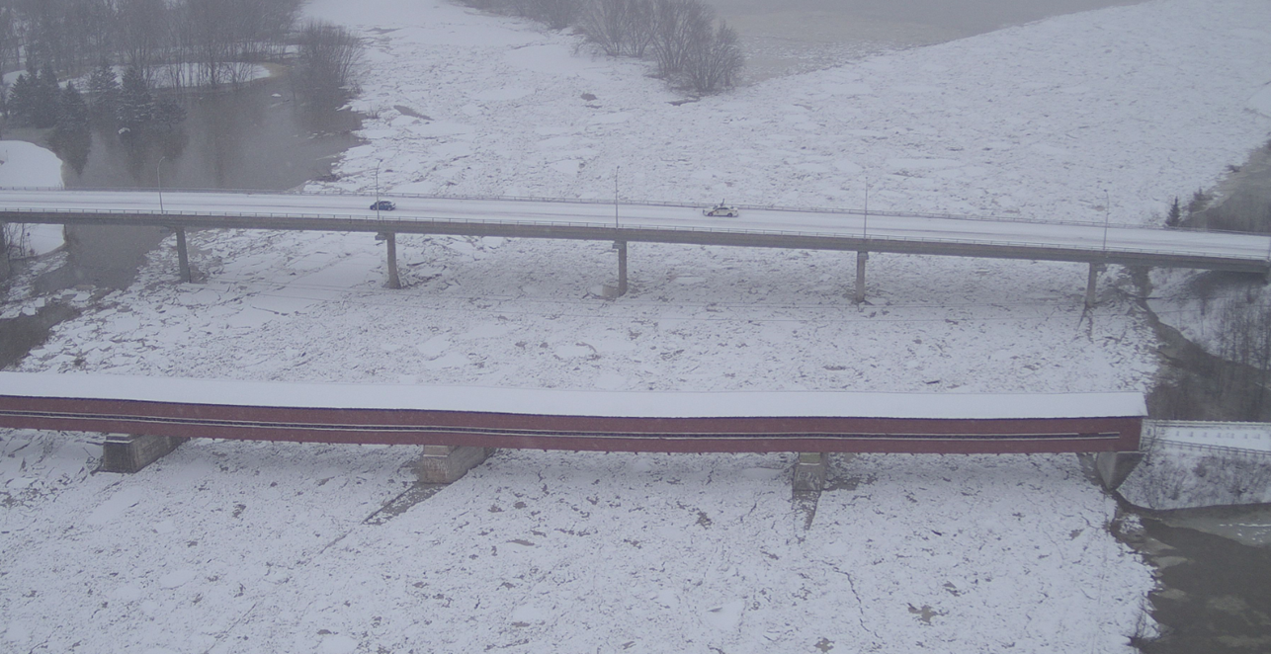
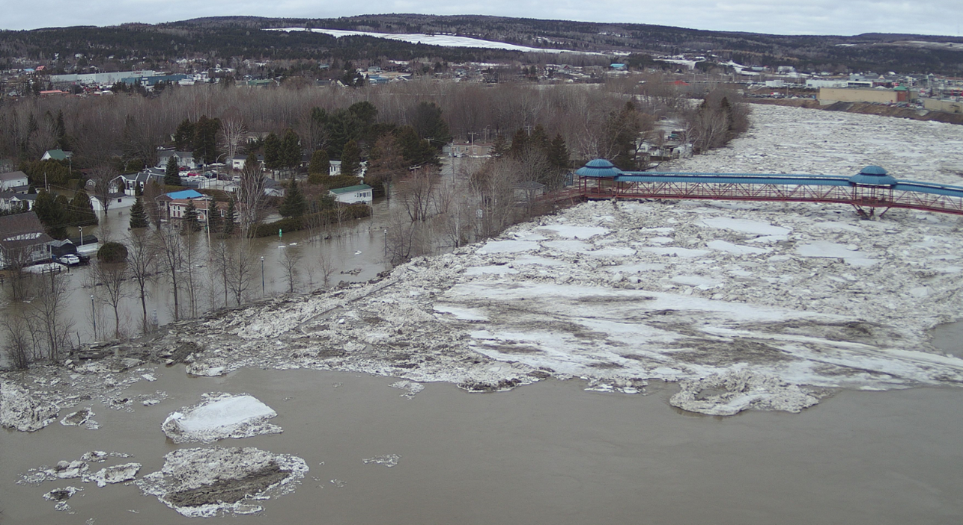
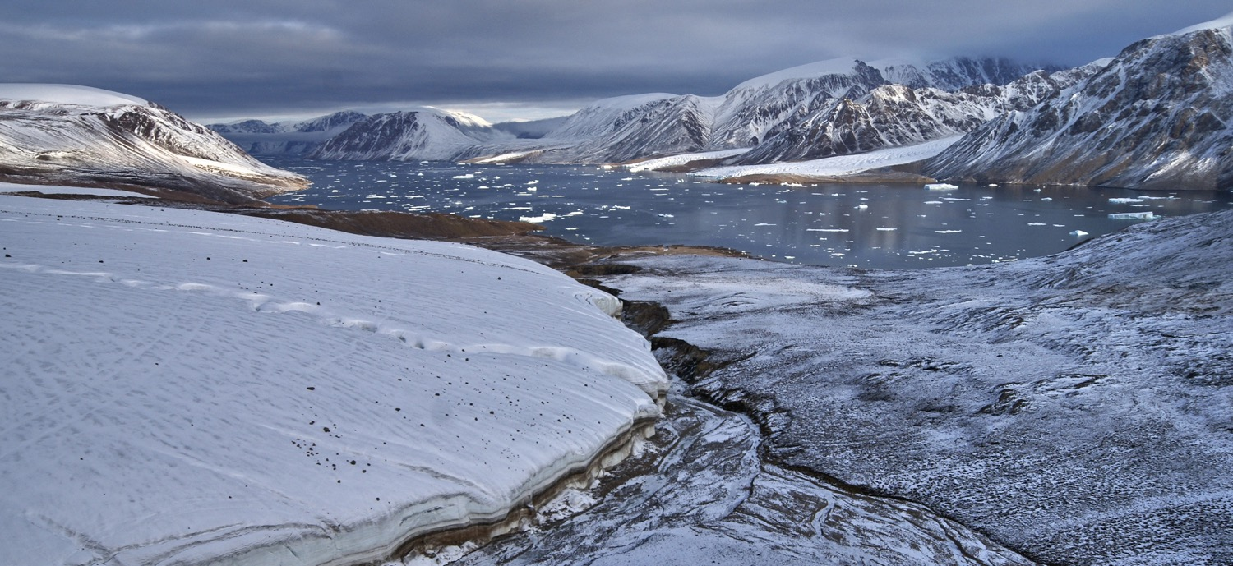
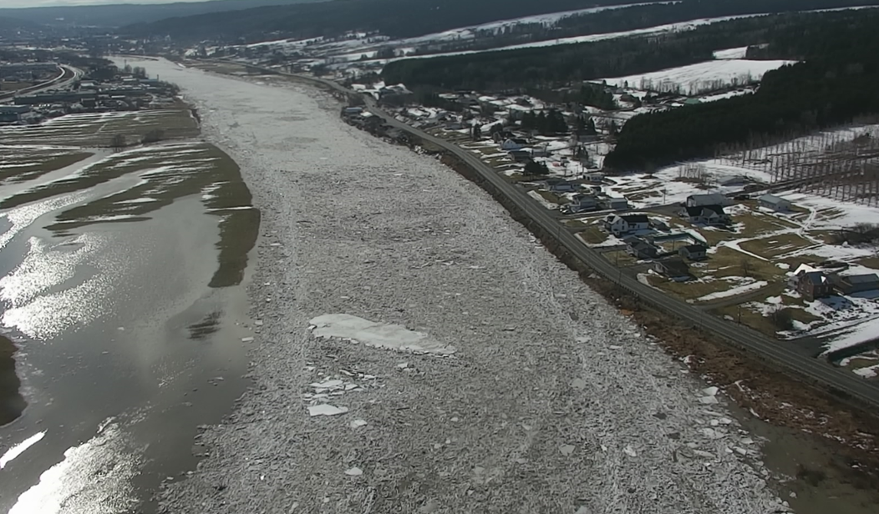






2025-Nov-20
Une approche intégrée pour la prévision des embâcles et des inondations à l’aide de modèles fondés sur les données
Par Amirhossein Salimi
Directeurs de recherche:
Tadros Ghobrial¹, Hossein Bonakdari²
1er Forum étudiant du RIISQ sur les risques d’inondation au Québec
UQAM, Montreal, CA
¹Department of Civil and Water Engineering, Université Laval,
²Department of Civil Engineering, University of Ottawa
Notes:
Hello every one
It’s a pleasure to meet you all, and I’d like to thank RIISQ for giving me the opportunity to present my PhD research at this first student forum.
My name is Amirhosssein salimi from Laval University and my thesis focuses on developing data driven approach to predict IJF at Quebec
Throughout this journey, I have been supervised by Dr. Ghobrial from Université Laval and Dr. Bonakdari from the University of Ottawa
An integrated approach to forecast ice jam flooding using data driven models

Slide 2
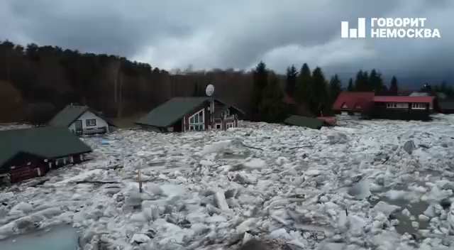

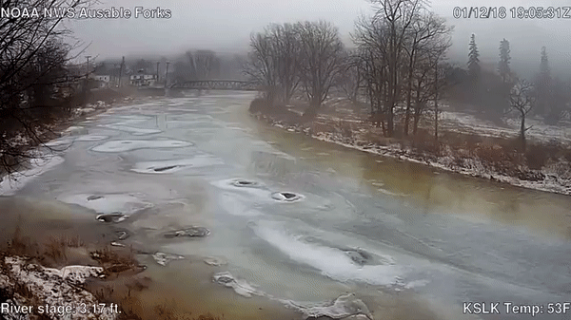
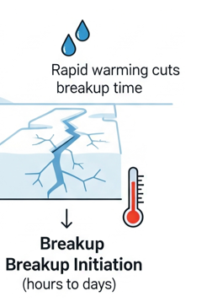
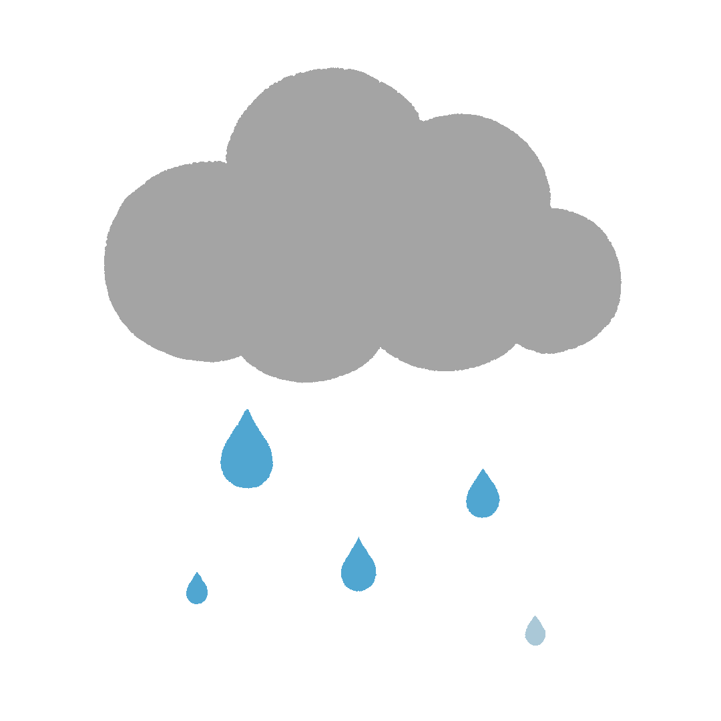
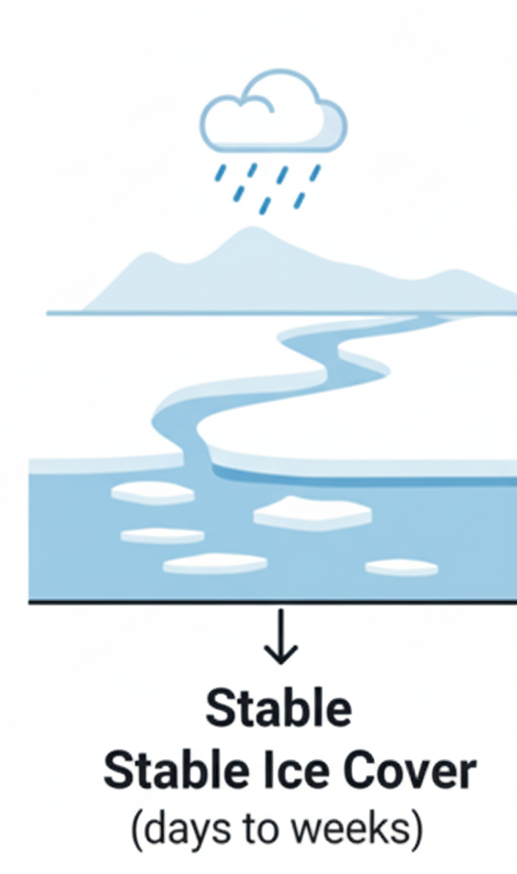
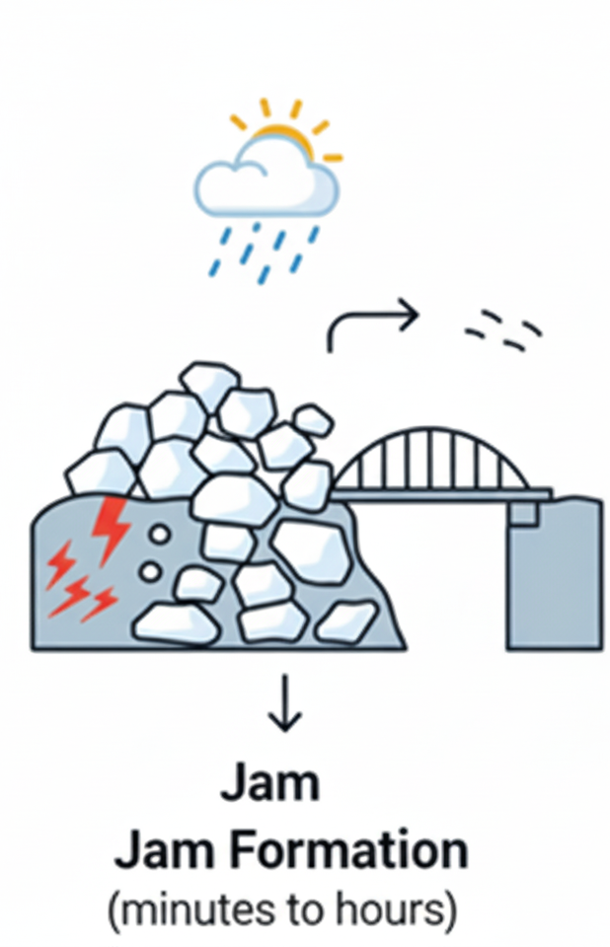
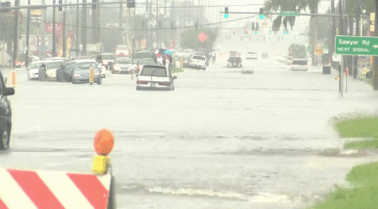

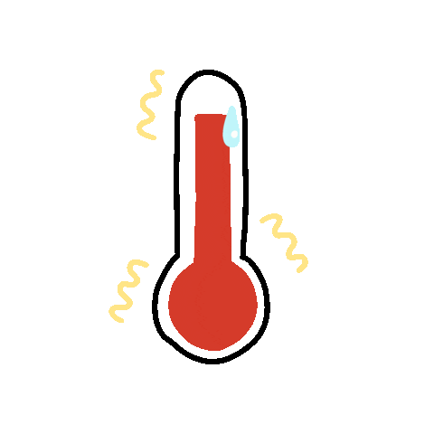
Introduction
2
Qu’est-ce qu’une inondation causée par un embâcle de glace ?
Les rivières en climat froid subissent deux types d’inondations : en eau libre et par embâcles de glace (IJFs).
Comment se produisent les IJFs?
Ils sont difficiles à prévoir à cause de processus physiques complexes.
La vidéo a été générée par intelligence artificielle et n’est pas réelle.
Ausable River, Au Sable Forks NY, USA, 2018.
Notes:
Today we’ll start with an introduction to IJF,
(Click) River in cold region experience another type of flood know as IJF
So let see, what exactly is an ice jam flood?
(Click) As temperatures rise and/or runoff increases, the frozen river surface weakens and breaks into ice blocks.
(Click) These blocks start to move with the flow until they encounter an obstacle, such as a bridge or a narrow river section.
This blockage causes the ice to accumulate, forming an ice jam, which leads to a sudden rise in water levels (see figure)
(Click) With continued warming, this temporary “ice dam” becomes unstable.
(Click) Once it collapses, it releases a mixture of water and ice that was trapped behind it, resulting in an ice jam flood.
Because of these complex physical processes, it’s very difficult to predict the combination of conditions that lead to an IJF, and/ or when it happen and /or the maximum water level associated with it, known respectively as the occurrence, timing, and severity of the IJF.
-------------
This WL is higher than open water level and can reach 2 to 3 times bigger than open-water condition in same condition.
Max.WL is function of length and volume of ice jam.
Ice jam length is the total distance upstream covered by the accumulation of ice blocking the river flow. Ice jam volume refers to the three-dimensional mass of ice, factoring in its length, width, and depth.
These two parameters are closely linked to flood severity—longer and more voluminous ice jams increase the resistance to water flow, causing higher upstream water levels.

Slide 3
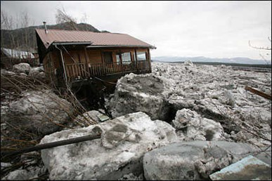
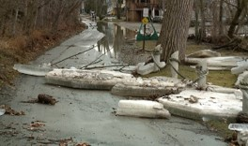
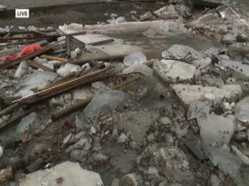
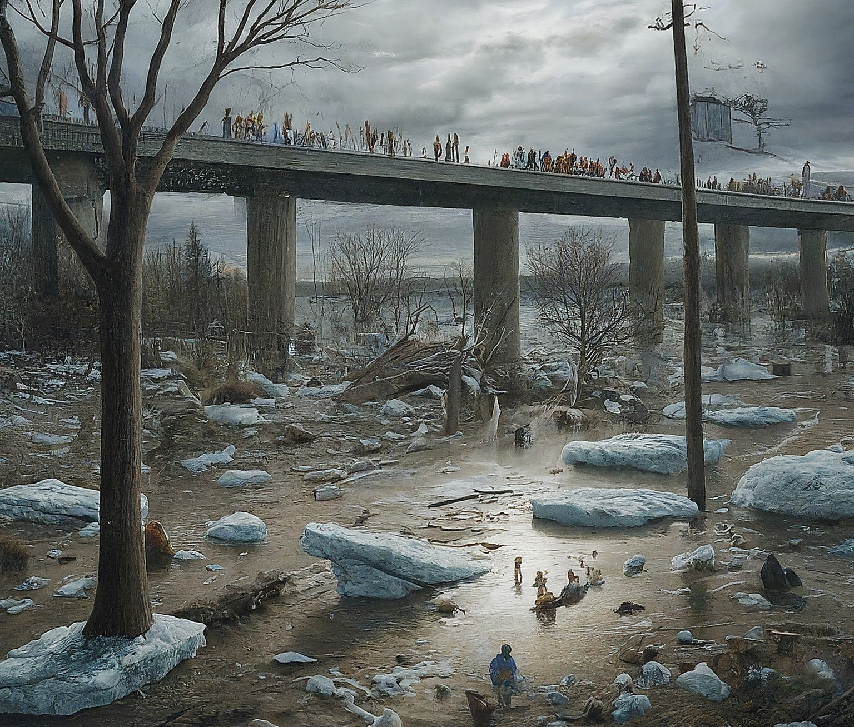
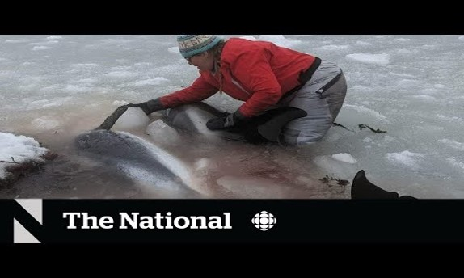
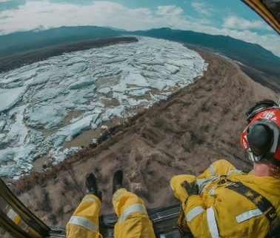
Introduction
3
1
Pourquoi les IJFs sont-elles importantes ?
2
Impacts économiques
Impacts sociaux
Impacts écologiques
Photo by AP 8 May 2009
3
Photojournalist Brian Sobolewski
The pictures generated by Gemini Google and are not real.
Photo by WEWS
by CBC News, 2023
Notes:
As IJF has serious
Economic (Property damage, Crop damage, Insurance costs)
Social (Displacement and relocation of residents)
Ecological (Habitat alteration, water quality)
Effect especially in Canada, (See figure) it is therefore worth investing in their prediction and management.
These events affect not only communities and local authorities,
but also lead to higher expenses for governments and the insurance industry

Slide 4
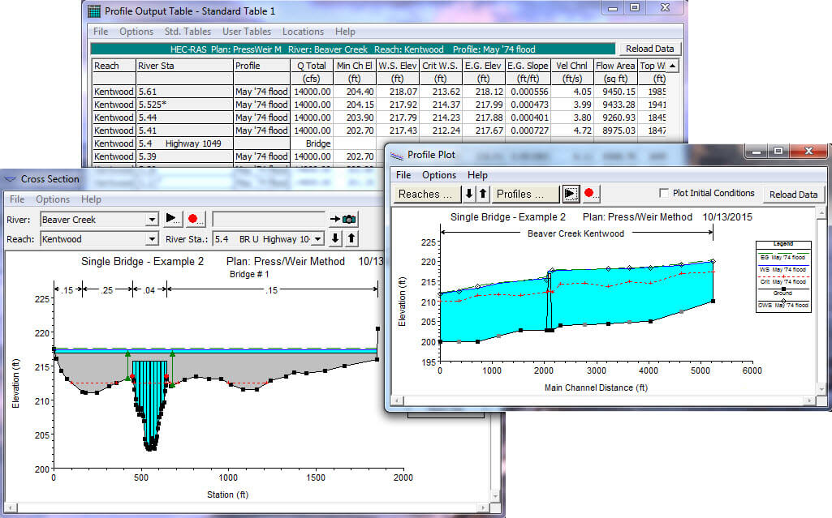
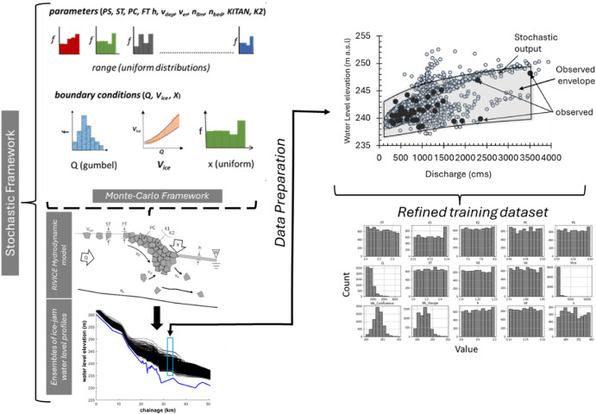
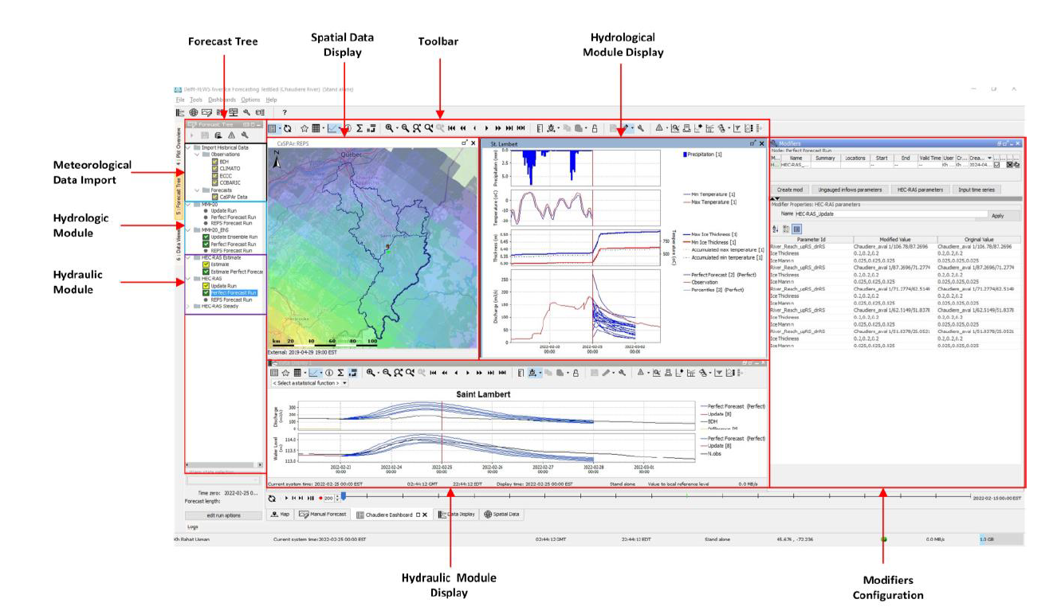



Introduction
4
Méthodes de prévision des IJF
Modèles hydrauliques
Modèles couplés
Méthodes fondées sur les données
HEC-RAS
CRISSP-1D
MIKE-ICE
RIVER1D
HEC-HMS & HEC-RAS
MESH & RIVICE
HOOPLA & HEC-RAS
Méthodes conceptuelles
Méthodes statistiques
Méthodes d’AI
Notes:
Many tools have been introduced to forecast IRFs, and we can put them into these three bowls.
In the first category, as you can see, we have well-known hydraulic software such as HEC-RAS. As an example, the main goal of it, is to simulate hydraulic conditions and equations related to IJFs, which helps estimate their severity.
However, these approaches often struggle because they require a lot of detailed data and extensive calibration.
Second, we have models that focus more directly on the physical processes of the phenomenon.
These approaches combine hydrologic or thermal models with hydraulic ones to predict features like the timing of an IJF (Click) similar to what our team has done in previous studies.
But, just like hydraulic models, they still face issues with data requirements and they add even more complexity to the calibration process.
Trying to reach IJF features based on observation records sorted in third one
(Click) In our team, we cover two methods of this one.
Since my study focuses on AI-based forecasting, let’s take a closer look at their limitations.
------
such as application of classical methods, using hydrologic models and coupled them by thermal models, physical-based models (Sarafanov et al. 2021), dendrogeomorphological methodd (Meseșan et al. 2019), hydraulic modeling(Ladouceur et al., 2023), empirical approaches, logistic regression, discriminant function analysis (White 2003, 2008), and multiple linear regression (Mahabir et al. 2006, 2008).

Slide 5

Lacunes de connaissances et limitations des études
5
Qualité des données insuffisante,
Effet de la taille et du déséquilibre des données peu étudié,
Embâcles liés aux interactions complexes souvent ignorés,
Identifier le modèle d’IA le plus stable.
The picture generated by Gemini Google and are not real.
Notes:
Regarding to previous studies,
It’s obvious that there are still important knowledge gaps that have been reported and need to be addressed
Here you can see some of the most common gaps, range from problems with data to finding model and tackling with complex physical process
------------
Insufficient data quality: often raw datasets with missing values, sensor errors, and uncorrected inconsistencies.
The effect of data size and imbalance is poorly studied.
Parameterization and calibration are difficult, especially for hybrid models.
IJFs caused by JAVEs and complex physical interactions are often overlooked.
No existing research predicts ice-jam length or volume using AI approaches.
Few models are tested across rivers or downstream sites, limiting transferability and generalization.

Slide 6
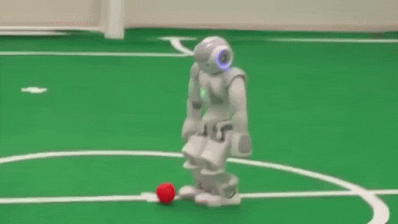

Objectifs de cette étude
6
But de la recherche :
  Développer une approche intégrée pour la prévision des inondations causées par les embâcles de glace à l’aide de modèles fondés sur les données.
Objectifs spécifiques :
  Analyser l’effet des méthodes de prétraitement sur la précision des modèles,
  Identifier les meilleurs modèles d’apprentissage automatique pour prédire les embâcles et les inondations par embâcle,
  Évaluer l’influence des données d’observation limitées sur la précision des modèles.
Notes:
Now, let see if AI can act as a superhero for us?
To be honest it’s not that easy,
before facing the big boss, we’ve got to fix all the mini-bugs first.
We need to address
1- → How can we overcome data scarcity and its impact on model performance?
2- → Can AI truly predict ice jams, and which algorithms perform best?
3- Can the approach be used when observational data are limited, and how does this affect accuracy?

Slide 7
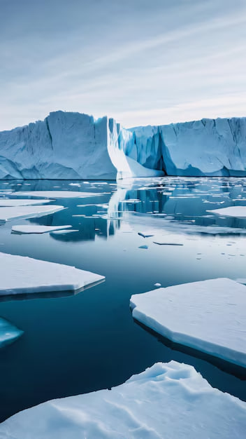
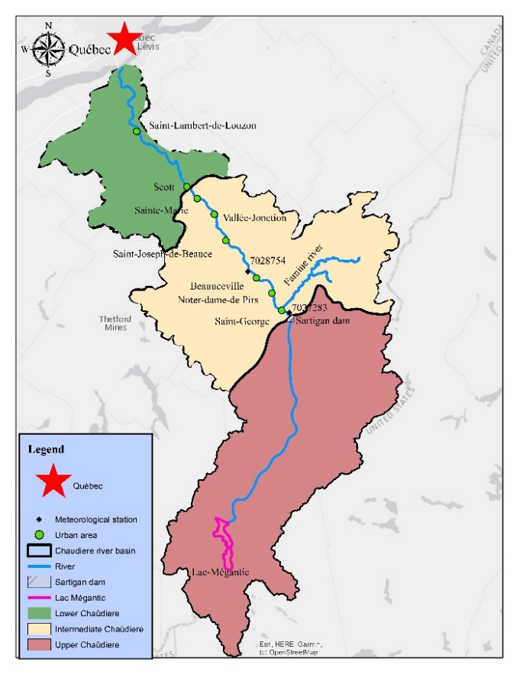
Étude de cas
7
Longueur = 192 km
Superficie du bassin versant = 6695 km²
Comprend 8 centres urbains
Centres urbains ciblés = Beauceville
Reach | Stationnement
 | Upstream | Downstream
Chaudière supérieure | 188.0 | 102.6
Chaudière intermédiaire | 102.6 | 39.3
Chaudière inférieure | 39.3 | 0
Notre-Dame
-des-Pins
Notes:
Let follow by the methodology developed for this research.
So before any action, we need find a city to save,
Here you can see the features of our study site.
It is a river in the south of Quebec City, known as the Chaudière River, which originates from Lake Mégantic and flows through the beautiful southern plains to reach the Saint Lawrence River.
This study mainly focuses on the middle section of the river.
We selected Saint-Georges, Beauceville, and Saint-Joseph because they are the most IJF-prone areas in this region, with 52% of events occurring in these towns.
------
Mainly work on intermediate Chaudière.
52% of these events occurring in these towns and half for all other locations.
Talk about the different of dataset they can provide (Snow on ground by StG)
Use both for models and difference between values are not so much
Meteorological stations (Beauceville operated by ECCC, St-Georges operated by government de Quebec)
Beauceville (Hourly, T, RH, total Pre, Wind) ----- for B & StJ
St-Georges (Daily, T, total Pre, Rainfall, Snowfall, Snow on ground) ---- for StG
Distance between cities is approximately 20 Km
Distances between Meteo to cities
StG meteo to B = (9 km)
StG meteo to StJ = (23 km)
B meteo to StG = (11.6 km)
B meteo to StJ = (13.8 km)
Hydraulic stations operated by CEHQ

Slide 8
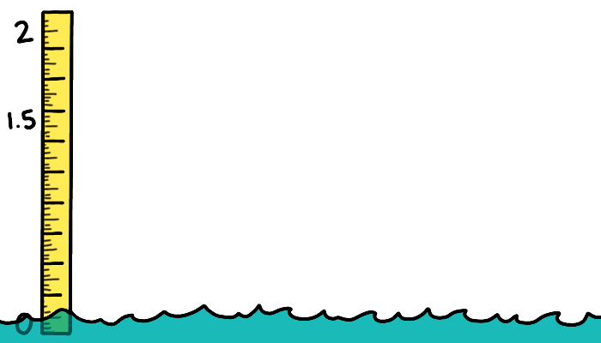

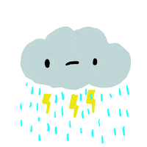


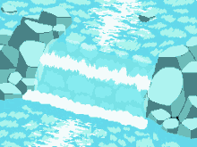





Données disponibles
8
Niveau d’eau
Quotidien
Précipitations totals
Température de l’air
Débit
Exemple d’un événement d’embâcle de glace à Saint-Joseph-de-Beauce
Hiver | Date | SSRC threshold | Niveau d’eau maximal
2015 | 14 Apr | 3 | 148.85
2016 | 04 Apr | 3 | 147.3
2017 | 11Apr | 3 | 148.64
2018 | 21-Mar | 1 | 150.611
2015
2024
Notre-Dame
-des-Pins
Notes:
To develop our data-driven model, we need daily datasets ranging from hydraulic to meteorological data, collected from the rich data sources in this region.
Hydraulic data were obtained from stations operated by CEHQ at Saint-Georges and Famine River, as well as from the water level monitoring system run by COBARIC.
We also use two meteorological stations, at Beauceville and Saint-Georges, operated by ECCC and the Government of Quebec, respectively, to collect the meteorological time series we need.
All these datasets would be useless without historical IJF information, which we obtained from Laval University’s River Ice Lab. These records serve as the target for our model.
---------
Mainly work on intermediate Chaudière.
52% of these events occurring in these towns and half for all other locations.
Talk about the different of dataset they can provide (Snow on ground by StG)
Use both for models and difference between values are not so much
Meteorological stations (Beauceville operated by ECCC, St-Georges operated by government de Quebec)
Beauceville (Hourly, T, RH, total Pre, Wind) ----- for B & StJ
St-Georges (Daily, T, total Pre, Rainfall, Snowfall, Snow on ground) ---- for StG
Distance between cities is approximately 20 Km
Distances between Meteo to cities
StG meteo to B = (9 km)
StG meteo to StJ = (23 km)
B meteo to StG = (11.6 km)
B meteo to StJ = (13.8 km)
Hydraulic stations operated by CEHQ

Slide 9

Organigramme méthodologique
9
1- Manque de données
Méthodes de prétraitement appliquées
  Remplissage des données manquantes
  Détection des valeurs aberrantes
  Vérification de la qualité des données
    Tests de détection de
    points de changement
    Tests d’homogénéité
Modèles de ML appliqués
  Desicion Tree (DT)
  Support Vector Machine (SVM)
  K-Nearest Neighbor (kNN)
  Extreme Learning Machine (ELM)
  Random Forest (RF)
2- Prédiction par IA
3- Longueur des données
Notes:
Now, let’s look at the proposed method, which aims to address our first four questions before we go through the results,
to see whether we can be a bit like Batman, and maybe not save the world, but at least save this region!!
After collecting data from various sources, we identified some issues, such as missing data or sensor malfunctions, which needed to be addressed before moving forward.
To overcome these problems, we applied several preprocessing techniques to build a complete data-driven model capable of handling field-related issues.
Based on literature review, we selected a range of machine learning models, from Decision Trees to ELM, not only to predict the IJF process but also to identify the best-performing models.
To assess the effect of data length, we defined five scenarios with different dataset sizes to examine their impact on model accuracy.
Finally, we tested the ability of the developed model to predict multi-class IJF events in other towns within the basin by re-running the calibrated model from Beauceville to Saint-Joseph, a nearby town.

Slide 10
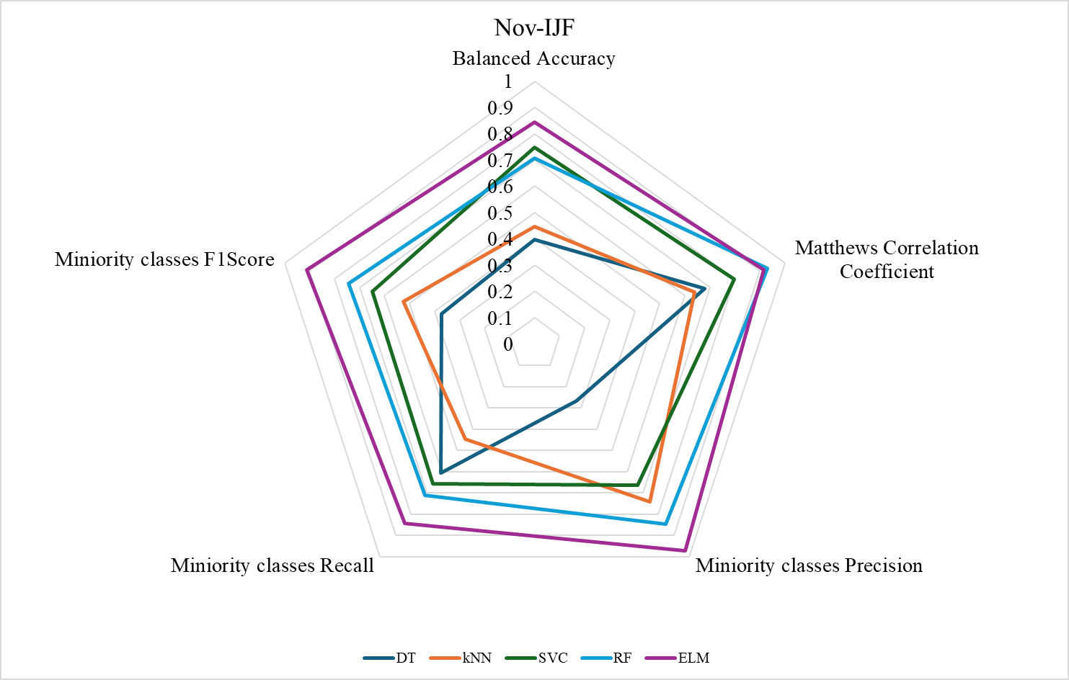
Résultats
10
Performance par model
Métriques pour comparer les modèles :
  Performance générale :
    Balanced Accuracy
    Matthews Correlation Coefficient (MCC)
  Classes minoritaires IJP :
    Précision
    Recall
    F1-Score
  L’IA peut-elle vraiment prévoir les embâcles, et quels algorithmes sont les plus efficaces ?
Performance générale → ELM et RF,
En considérant les métriques des classes minoritaires → ELM.
Notes:
Finally, let’s jump into the answers to our questions.
But we’ll start with the second question first — identifying the best model among those we examined.
Actually, I almost forgot it, so thanks to my notes for reminding me!
To do this and also for the reason of imbalance datasets, we used five performance metrics that take data imbalance into account, evaluating both overall performance and the performance for minority classes.
First, Balanced Accuracy was selected because traditional accuracy can be misleading when data are imbalanced — this metric shows how reliable the model is across all classes.
Next, we used the Matthews Correlation Coefficient (MCC), which gives a more complete picture of how well the model has actually learned. A high MCC means the model isn’t just guessing right by luck — it truly understands the data patterns.
As shown in the figure, ELM and RF achieved the highest values for these two metrics.
Then, to test how well models handle the minority class — the actual IJF events, which represent only about 13 out of 1600 samples — we calculated precision, recall, and F1-score.
Our goal was to find all real IJFs — that’s high recall — but without generating false flood alarms — that’s high precision.
When combining these two, the F1-score confirmed that ELM outperformed the others, making it the most reliable model overall.”

Slide 11
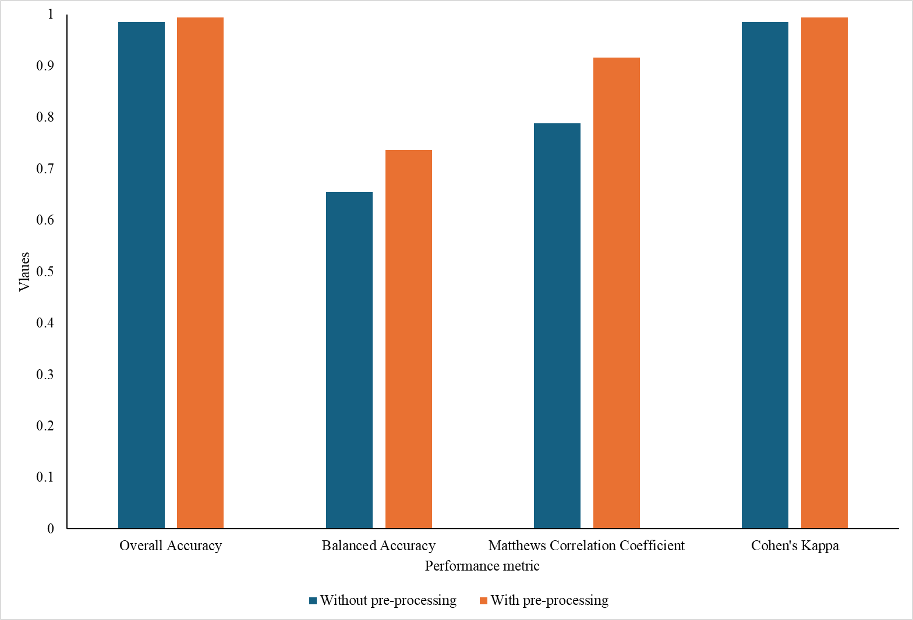
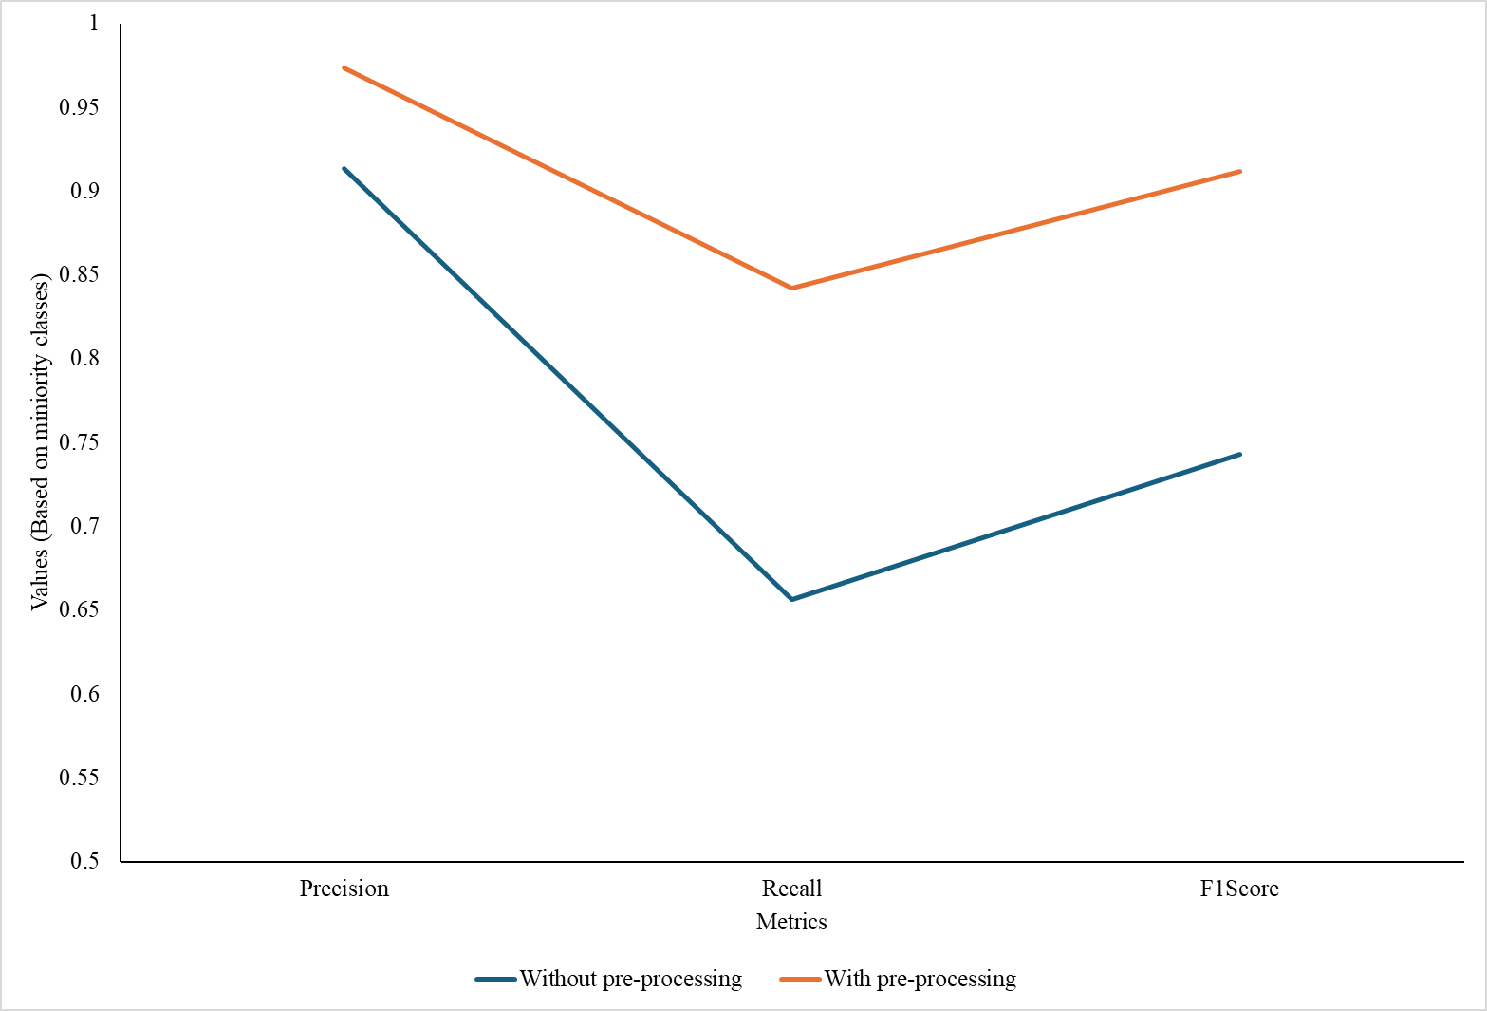

Résultats
11
  Comment surmonter le manque de données et son impact sur la performance des modèles ?
Effet du prétraitement
Le prétraitement améliore la performance pour la prédiction à la fois de la classe générale et de la classe minoritaire.
Notes:
“Now it’s time to talk about the pre-processing measures we applied and how they affect model performance.
To evaluate their impact, we re-ran the best model on two datasets: one before pre-processing and one after.
Looking at the bar chart, we can see that pre-processing clearly improves overall performance — Balanced Accuracy, MCC, and Cohen’s Kappa all increase.
(As a reminder, Cohen’s Kappa is similar to MCC but specifically measures the agreement between predicted and actual classes, accounting for chance.)
But more importantly, these methods also boost performance for the minority classes.
Recall, in particular, shows a significant improvement, which means the model is better at detecting true ice-jam floods.
In short, pre-processing not only improves general accuracy but also makes the model more reliable for rare, critical events — exactly what we need for IJF prediction.”

Slide 12
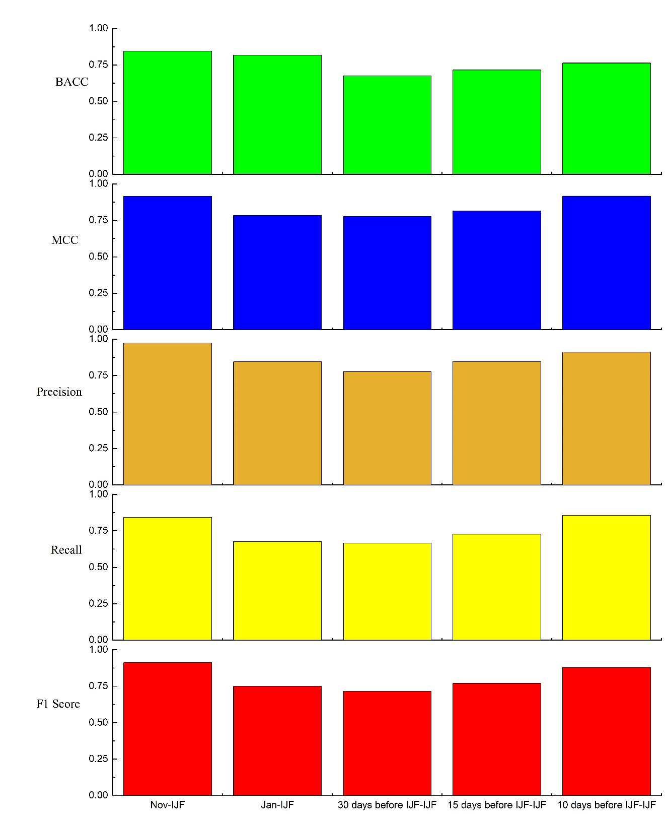
Résultats
12
Longueur des données
Résultats du meilleur modèle pour 5 longueur des données :
  Hiver complet (Nov → IJF)
  Janvier → IJF
  30 jours avant IJF → IJF
  15 jours avant IJF → IJF
  10 jours avant IJF → IJF
Plus de données → meilleure précision globale (BACC, MCC)
Classes minoritaires (événements IJF) : performance similaire pour 10 jours vs hiver complet
Compromis : les ensembles plus longs améliorent la performance générale mais peuvent augmenter les fausses alertes
  L’approche peut-elle être utilisée quand les données d’observation sont limitées, et comment cela affecte-t-il la précision ?
Notes:
“Here, we investigated how data length affects model performance by evaluating the best model on several scenarios.
Based on our five metrics, we can see a clear trend: the more data the model has, the more accurate it becomes.
This makes sense — more data allows the model to learn patterns better and make more reliable predictions.
Interestingly, for the minority class, which represents the actual ice-jam events, the model’s ability to detect them (recall) is very similar between the 10-day and full-winter datasets.
However, when we look at general performance metrics like Balanced Accuracy and MCC (model was able to understand trend), we notice a trade-off: the longer dataset slightly increases errors in terms of false alarms.
So, in short, more data generally improves accuracy, but it can also increase false alerts, highlighting the importance of balancing dataset length and reliability for real-world predictions.”

Slide 13
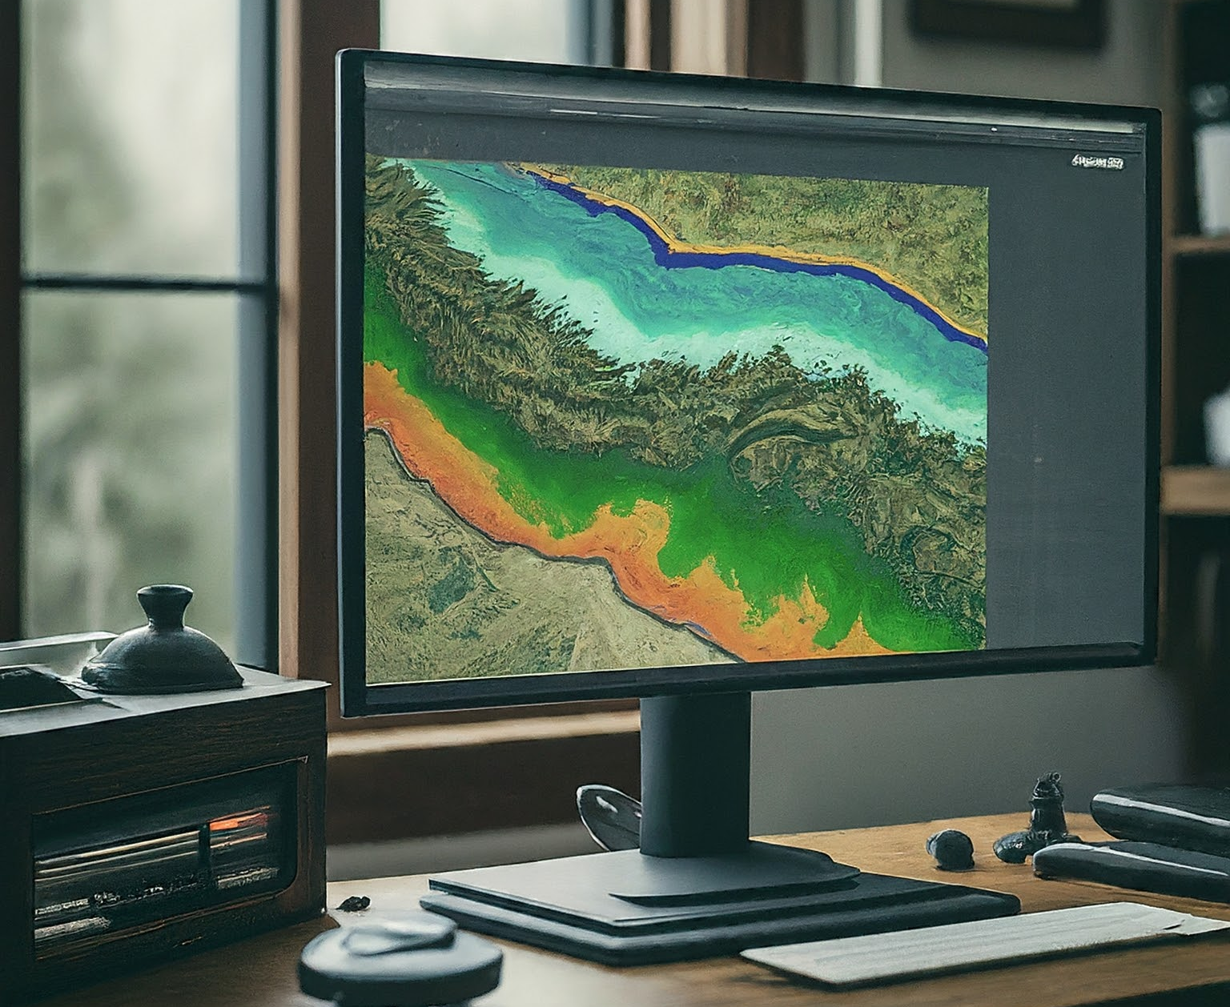
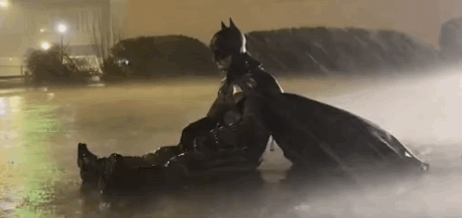
Résultats
14
Principaux résultats
  Prétraitement des données
  La qualité des données et le prétraitement sont essentiels pour une prévision fiable,
  Un prétraitement en plusieurs étapes améliore grandement la robustesse du modèle,
  Traitement et métriques
  L’ELM montre une performance solide et efficace sur le plan computationnel,
  Des métriques équilibrées (BACC, MCC, macro-F1) offrent une évaluation plus équitable des modèles,
  Le longueur des donnéesle plus performant est Nov-IJF.
Notes:
To sum up, here are the main findings
First, data preprocessing: good quality data and careful preprocessing are essential, and doing it in multiple steps makes the model more robust.
Second, processing and metrics: ELM performs very well and is computationally efficient. Using balanced metrics like BACC, MCC, and macro-F1 gives a fair evaluation, and the Nov-IJF scenario worked best.
Finally, transferability: the model can’t always be applied directly to other sites — local calibration is needed.” and still need to improvement
----
Data pre-processing
Data quality and preprocessing are critical for reliable prediction,
Multi-step preprocessing greatly enhances model robustness,
Processing & Metrics
ELM demonstrates strong and computationally efficient performance,
Balanced metrics (BACC, MCC, macro-F1) provide fairer model evaluation,
The best-performing scenario is Nov-IJF,
Transferability
Model transferability is site-dependent, highlighting the need for local calibration

Slide 14
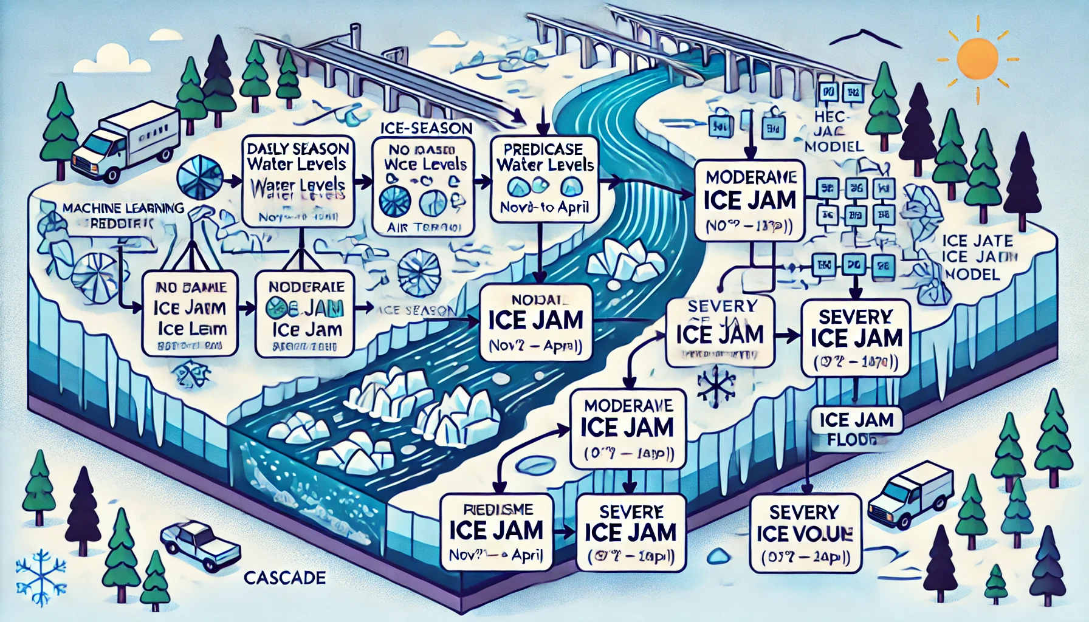
Prochaines étapes
15
Intégrer des modèles hydrologiques et hydrauliques,
Appliquer des techniques alternatives d’exploration de données afin d’assurer la qualité et la fiabilité des données,
Améliorer l’applicabilité grâce à de nouveaux algorithmes d’apprentissage automatique
Notes:
So, we saw there’s still a long way to go before becoming a ‘superhero,’ and after all of this, we face some new questions that need to be addressed:
How to better incorporate hydrologic and hydraulic models.
How to apply alternative data mining techniques to ensure data quality and reliability.
How to enhance applicability by exploring new ML algorithms.”

Slide 15
Remerciements
16
Un remerciement tout particulier à
Gabriel Pelchat & Jean-Robert Ladouceur
Notes:
We would like to thank ECCC, Centreau and, Quebec’s Ministère de la Securite publique for funding this project
Sincerely acknowledge my professors, Tadros and Hossein for their supports
and my colleagues گابریل پلچات و ژان رابرت لادوسر for their invaluable help throughout this research.

Slide 16
Références
17
Beltaos, S. (Ed.). (1995). River ice jams. Water Resources Publication.
CEHQ. (2005). Rivière Chaudière – Municipalités régionales de comté de la Nouvelle-Beauce, de Robert-Cliche et de Beauce-Sartigan - Révision des cotes d’inondations de récurrence de 20 ans et de 100 ans. Rapport CEHQ-12-001. Ministère de l'Environnement et de la Lutte contre les changements climatiques du Québec. 180 p.
COBARIC 2014 Plan directeur de l’eau du bassin versant de la rivière Chaudière : Mise à jour 2014 – Portrait. Comité de bassin de la rivière Chaudière, Sainte-Marie, Quebec.
De Coste, M., Li, Z., Pupek, D., & Sun, W. (2021). A hybrid ensemble modelling framework for the prediction of breakup ice jams on Northern Canadian Rivers. Cold Regions Science and Technology, 189, 103302.
De Coste, M., Li, Z., & Khedri, R. (2023). The prediction of mid-winter and spring breakups of ice cover on Canadian rivers using a hybrid ontology-based and machine learning model. Environmental Modelling & Software, 160, 105577.
de Rham, L., Dibike, Y., Beltaos, S., Peters, D., Bonsal, B., & Prowse, T. (2020). A Canadian river ice database from the national hydrometric program archives. Earth System Science Data, 12(3), 1835-1860.
Ghobrial, T., Pelchat, G., & Morse, B. (2023). A comprehensive field investigation of the dynamic break-up processes on the Chaudière River, Quebec, Canada. Hydrology Research.
Hicks, F. E. (2016). An introduction to river ice engineering for civil engineers and geoscientists. CreateSpace Independent Publishing Platform.
Ladouceur, J. R., Morse, B., & Lindenschmidt, K. E. (2023). A comprehensive method to estimate flood levels of rivers subject to ice jams: A case study of the Chaudière River, Québec, Canada. Hydrology Research, 54(9), 995-1016.
Madaeni, F., Chokmani, K., Lhissou, R., Homayouni​​​​​​​, S., Gauthier, Y., & Tolszczuk-Leclerc, S. (2022). Convolutional neural network and long short-term memory models for ice-jam predictions. The Cryosphere, 16(4), 1447-1468.
Pelchat, P., & Morse, B. (2022). Détermination des cotes d’inondation en présence de glace sur la rivière Chaudière – Approche historique appliquée aux centres urbains situés entre Saint-Georges et Saint-Lambert-de-Lauzon, 1-59.
Rokaya, P., Lindenschmidt, K. E., Pietroniro, A., & Clark, M. (2022). Modelling of ice jam floods under past and future climates: A review. Journal of Hydrology X, 15, 100120.
Salimi, A., Ghobrial, T., & Bonakdari, H. (2024 A). A comprehensive review of AI-based methods used for forecasting ice jam floods occurrence, severity, timing, and location. Cold Regions Science and Technology, 227, 104305.
Salimi, A., Ghobrial, T., & Bonakdari, H. (2024B). Evaluating data preparation techniques on machine learning forecasting of Ice Jam Flood occurrence: A case study on the Chaudière River. 27th IAHR International Symposium on Ice Gdańsk, Poland, 9–13 June 2024. 27th IAHR, 123.
Salimi, A., Ghobrial, T., & Bonakdari, H. (2025) A Comparison between machine learning approaches for forecasting Ice Jam Flood occurrence: A case study on the Chaudière River. 23rd Workshop on the Hydraulics of Ice Covered Rivers, St. John’s, Newfoundland and Labrador, Canada, 9–12 June 2025.
Sun, W., Lv, Y., Li, G., & Chen, Y. (2020). Modeling river ice breakup dates by k-nearest neighbor ensemble. Water, 12(1), 220.
Zhao, L., Hicks, F., Fayek, A. R., & Kovachis, N. (2010, June). Forecasting the onset of breakup using artificial neural networks. In 20th IAHR International Symposium on Ice.

Slide 17
Merci!
Department of Civil & Water Engineering, Laval University
Amirhossein.salimi.1@ulaval.ca
Notes:
Thanks again to RIISQ and Thank you so much for your attention

Slide 18
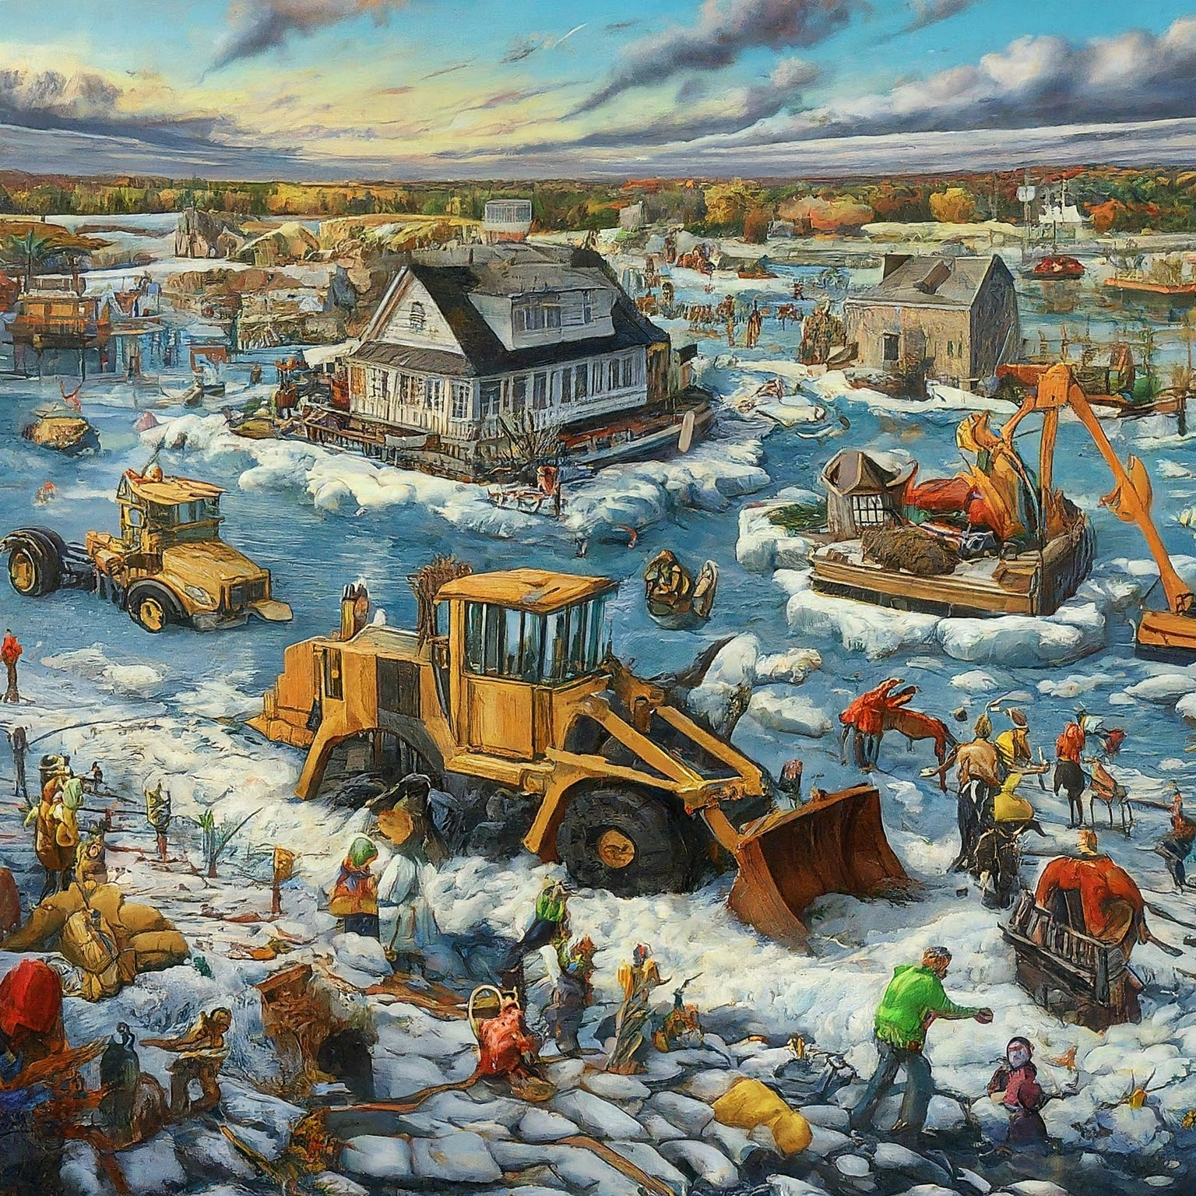
Q & A
Notes:
“Now, it’s my pleasure to answer your questions.”

Slide 19
Extra

Slide 20


River flow
E1
Q_{Saint-george} = Q_{Sartigan dam}
Q_{Beauceville} = Q_{Famine} + Q_{Sartigan dam}
River (north to south) | Watershed area (km²) | Watershed area at the confluence of the Chaudière River (km²)
Downstream study limit Bridge 216 (St-Lambert) | – | 5,845
Bras-Victor River | 730 | 5,059.4
Famine River | 714 | 3,820.4
Upstream study limit (Sartigan Dam) | – | 3,085
Bras-victor river
Q_{Bras-Victor river} = Q_{Beauceville} (A_{Bras-Vicor river}/ A_{Tot})
Q_{Saint-joseph-de-beauce} = Q_{Beauceville +} Q_{Bras-Victor river}
Notes:
Method from Ladouceur, J. R., et al.,(2023).
A comprehensive method to estimate flood levels of rivers subject to ice jams: A case study of the Chaudière River, Québec, Canada

Slide 21
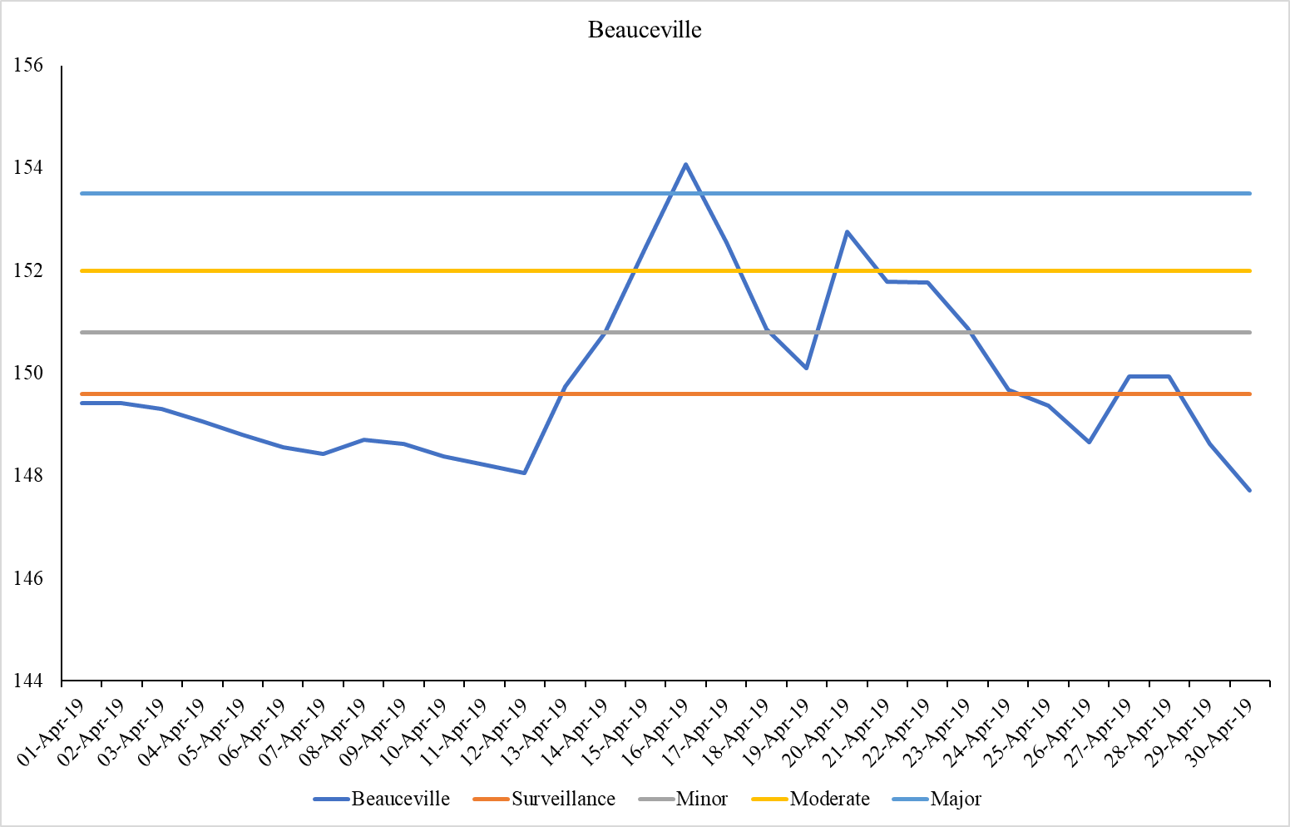
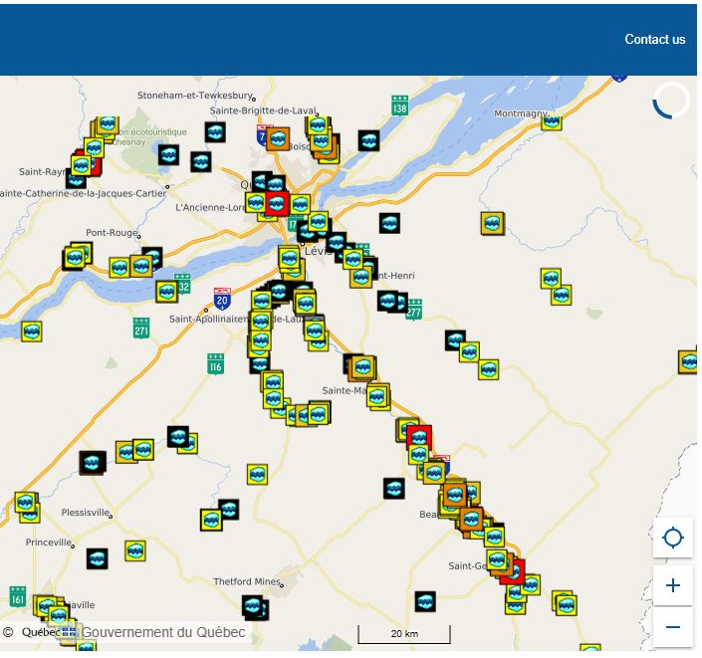
Introduction
E2
Différents phénomènes IJP
Sa cote maximale d’eau ?= Severity
Événement post-inondation
Est-ce que cela se produit ou non ?
= Occurrence
WL
Lieu
Quand cela se produit-il ?
= Timing
from MSP’s interactive map
Notes:
This is an example of WL in Beauceville during 2019 winter season.
it is an Example of MSP’s interactive map near Québec City, Canada (accessible 01 June 2023).
It contains information about the time and location of IJF in Quebec.
Each icon leads to information on the event, and the label color is based on the event severity and classified into six levels: none, minor, moderate, major, extreme, unknown.
In Occurrence period, WL start to increase, and just in local release, it starts to drop. Just after this release, the river experience some increases again called post-breakup JAVEs
Post-breakup JAVE is cause by departure of ice from upstream
A peak after IJF event, was an extreme Pre (36 mm ). (But you can see (but in less severity) some days after local release like post breakup JAVEs).

Slide 22

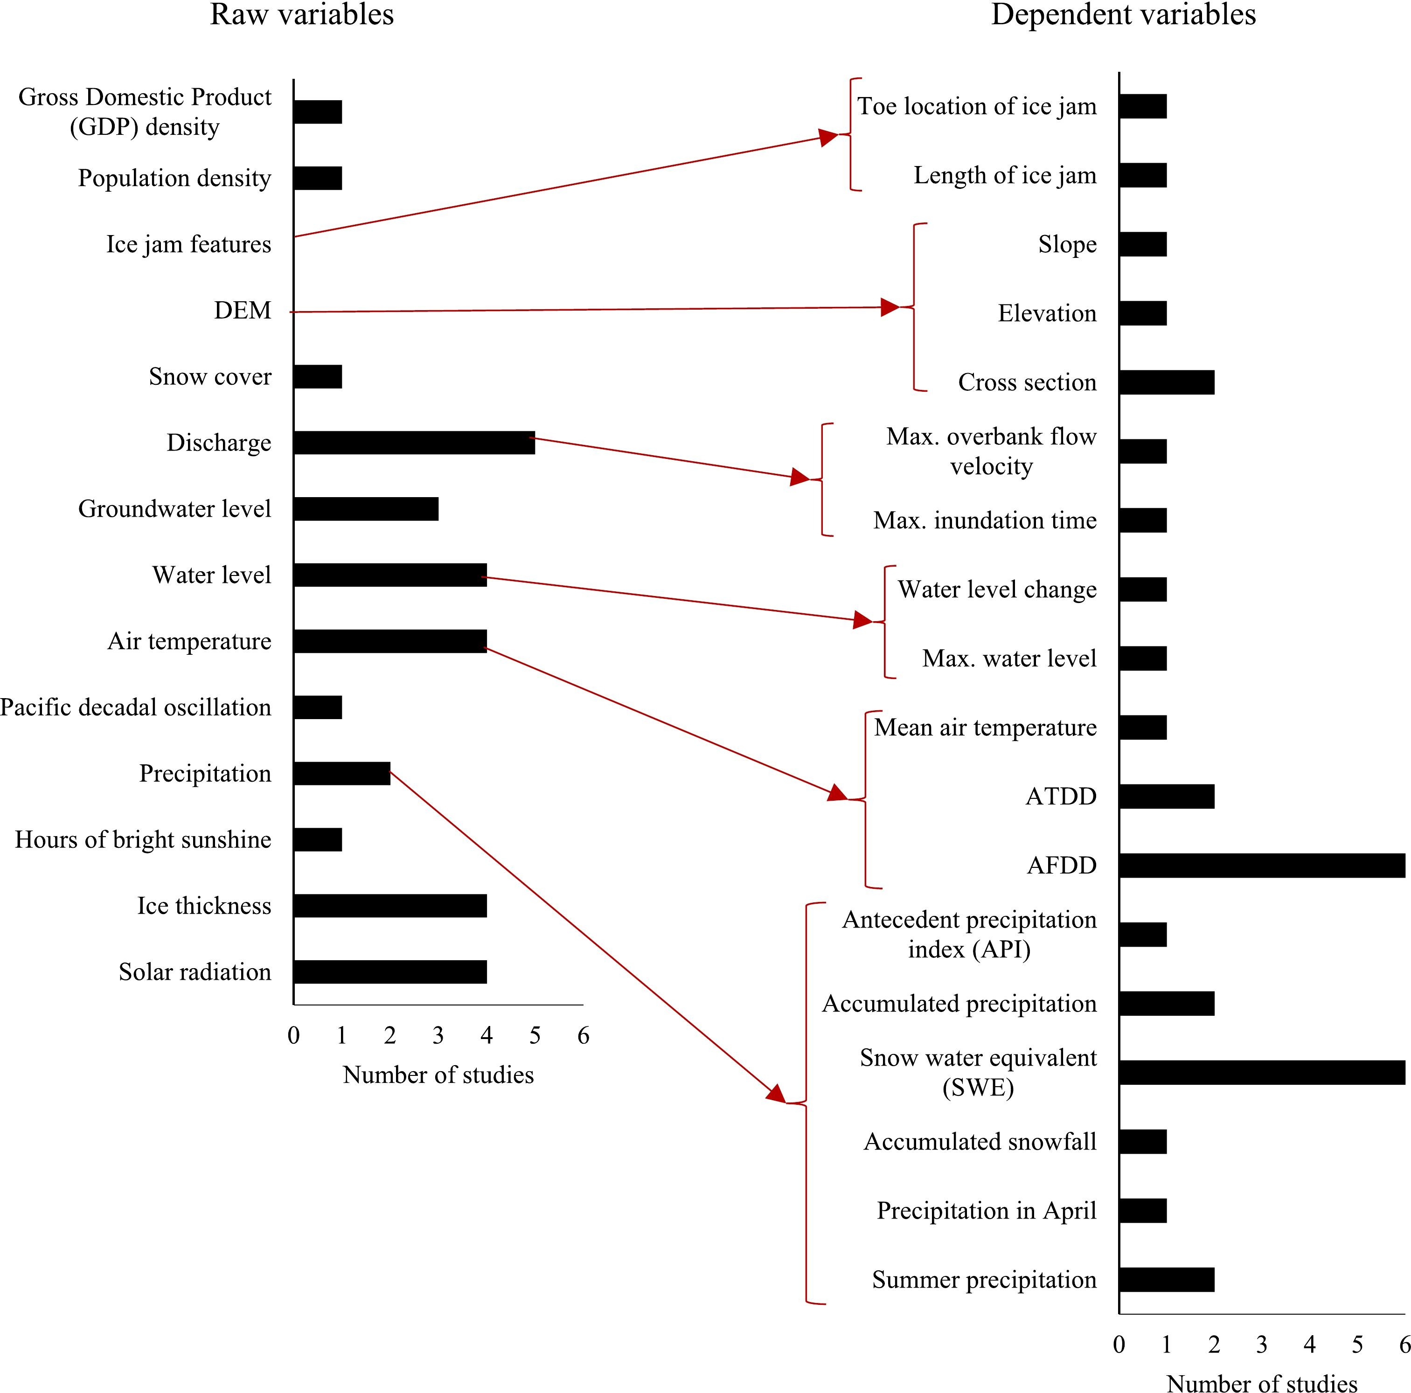
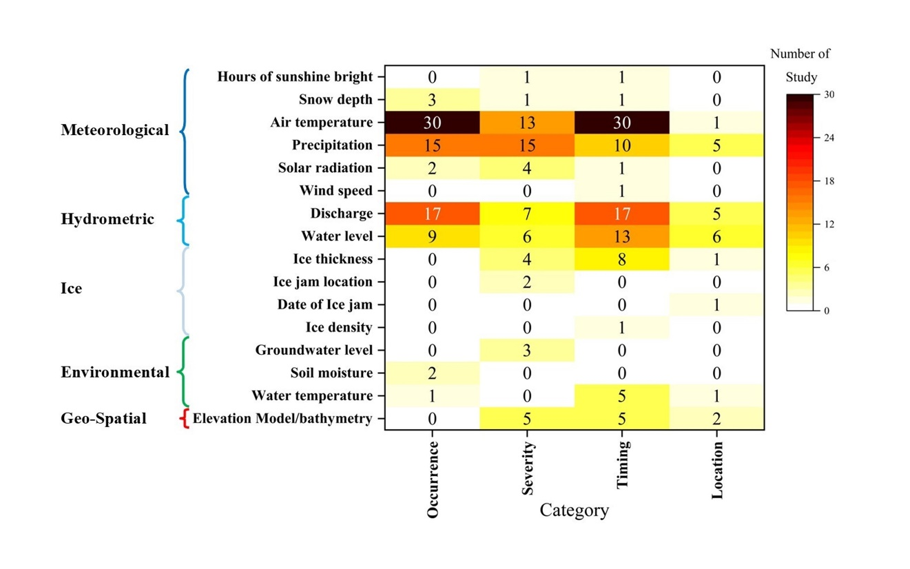

Résultats
E3
Objectif 1
Après application des critères :
64 publications retenues
Severity
Notes:
This figure gives us a good overview of previous IJF studies using AI and shows what inputs were used in those models.

Slide 23
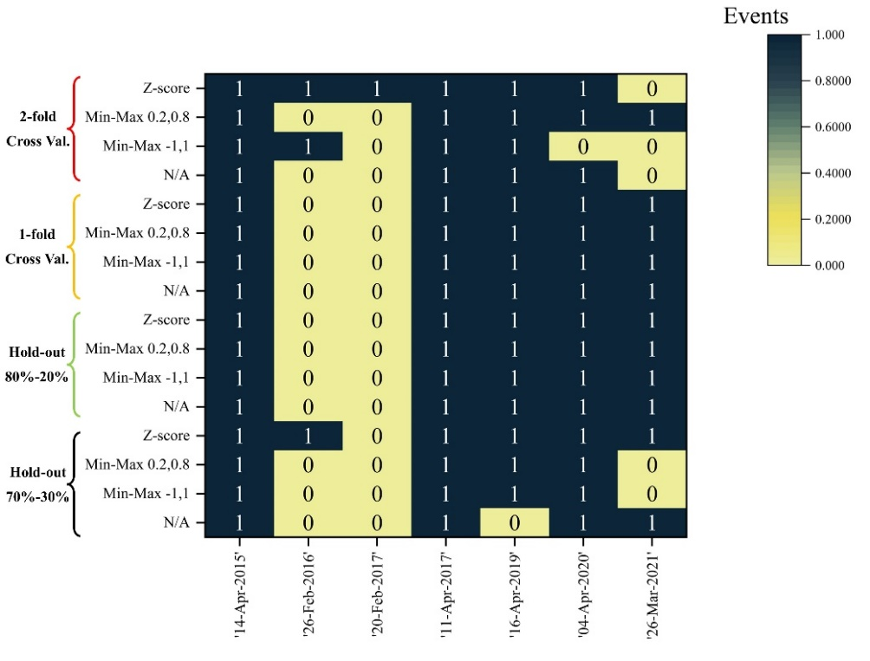
Résultats
Performance par événement
Les métriques ne permettent pas une comparaison très précise,
Les événements modérés sont prédits de manière quasi parfaite.
Suggestion?!
Counting the number of predicted events.
Suggestion?!
Need longest record.
E4

Slide 24


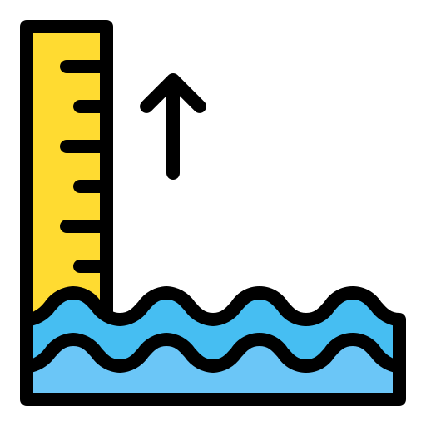

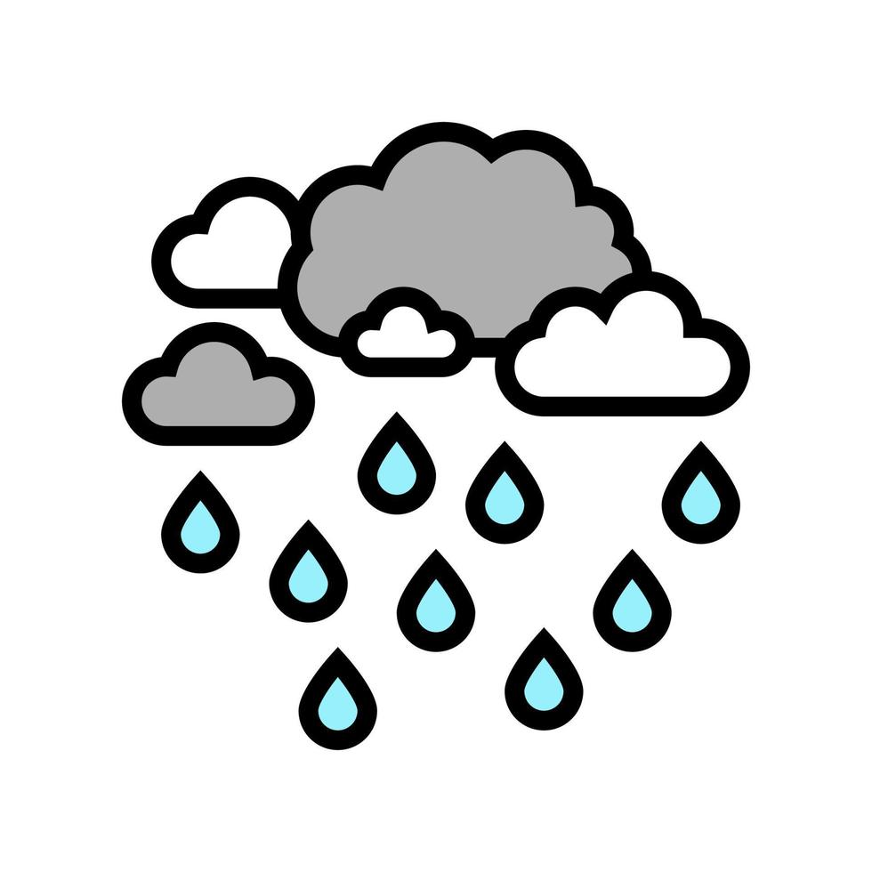
Résultats
E6
Sélection des variables
Method | Data period | WL | CDDT | Max Temp (°C) | Min Temp (°C) | Mean Temp (°C) | Total Precipitation | Discharge
Pearson | Nov-IJF | 0.21 | 0.39 | 0.16 | 0.12 | 0.15 | 0.07 | 0.45
 | 10 days before IJF | 0.52 | 0.37 | 0.15 | 0.20 | 0.19 | 0.11 | 0.73
Random Forest | Nov-IJF | 0.59* | 0.16 | 0.23 | 0.04 | 0.14 | 0.08 | 0.60
 | 10 days before IJF | 0.89 | 0.48 | 0.46 | 0.27 | 0.44 | 0.03 | 0.81
Mutual Information (MI) | Nov-IJF | 1** | 4 | 5 | 7 | 6 | 3 | 2
 | 10 days before IJF | 2 | 1 | 5 | 7 | 6 | 4 | 3
* Importance score
** MI rank
Pearson
Random Forest
Mutual Information (MI)
Q
CDDT
WL
Q
WL
Max T
CDDT
Q
CDDT
Pre
WL
Notes:
To understand which factors are most crucial for predicting ice jam floods, we employed three different feature selection methods
"Starting with Pearson correlation, which measures linear relationships, we see that discharge (Q) and cumulative degree days (CDDT) show the strongest linear correlation with flooding. Water level (WL) also exhibits a moderate positive linear relationship.“
"Moving to Random Forest, a non-linear method, water level (WL) emerges as the most important predictor, indicated by the highest score. Discharge (Q) and CDDT also remain significant, suggesting their strong predictive power even when considering complex, non-linear interactions within the data.“
"Finally, Mutual Information, which captures any statistical dependency (linear or non-linear), ranks the variables. Here, water level (WL) again stands out as the most informative feature for predicting floods. Discharge (Q) and total precipitation also appear as highly relevant predictors according to this method.“
"Overall, we observe a consistent emphasis on water level and discharge across all three methods, highlighting their fundamental role in ice jam flood formation. While Pearson focuses on linear connections, Random Forest and Mutual Information underscore the importance of water level and also point to the relevance of temperature accumulation and precipitation, potentially capturing more complex, non-linear influences. These insights guided us in selecting the most impactful features for our machine learning models, ultimately improving their predictive accuracy.“
"Random Forest assesses feature importance by seeing how often and how effectively each variable is used in its many decision trees to predict IJFs.“
MI quantifies how much information a specific weather or river variable provides about the occurrence of an ice jam flood.“
A higher MI score indicated a stronger statistical dependence and thus a greater relevance of that feature in predicting IJFs.

Slide 25
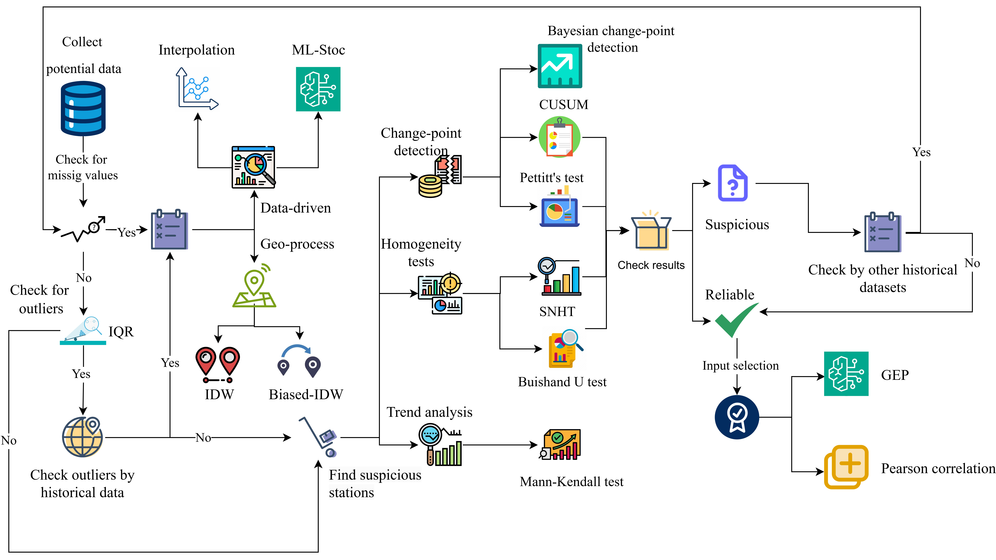
Résultats
E7
Nettoyage des données
Variable | Nombre de lacunes | Méthode(s) employée(s)
WL | 78 | IDW / MLR
Q | 88 | Ladouceur et al., 2023
Température de l’air | 6 | Remplacement par une station voisine
Précipitations totales | 7 | Re-analysis

Slide 26
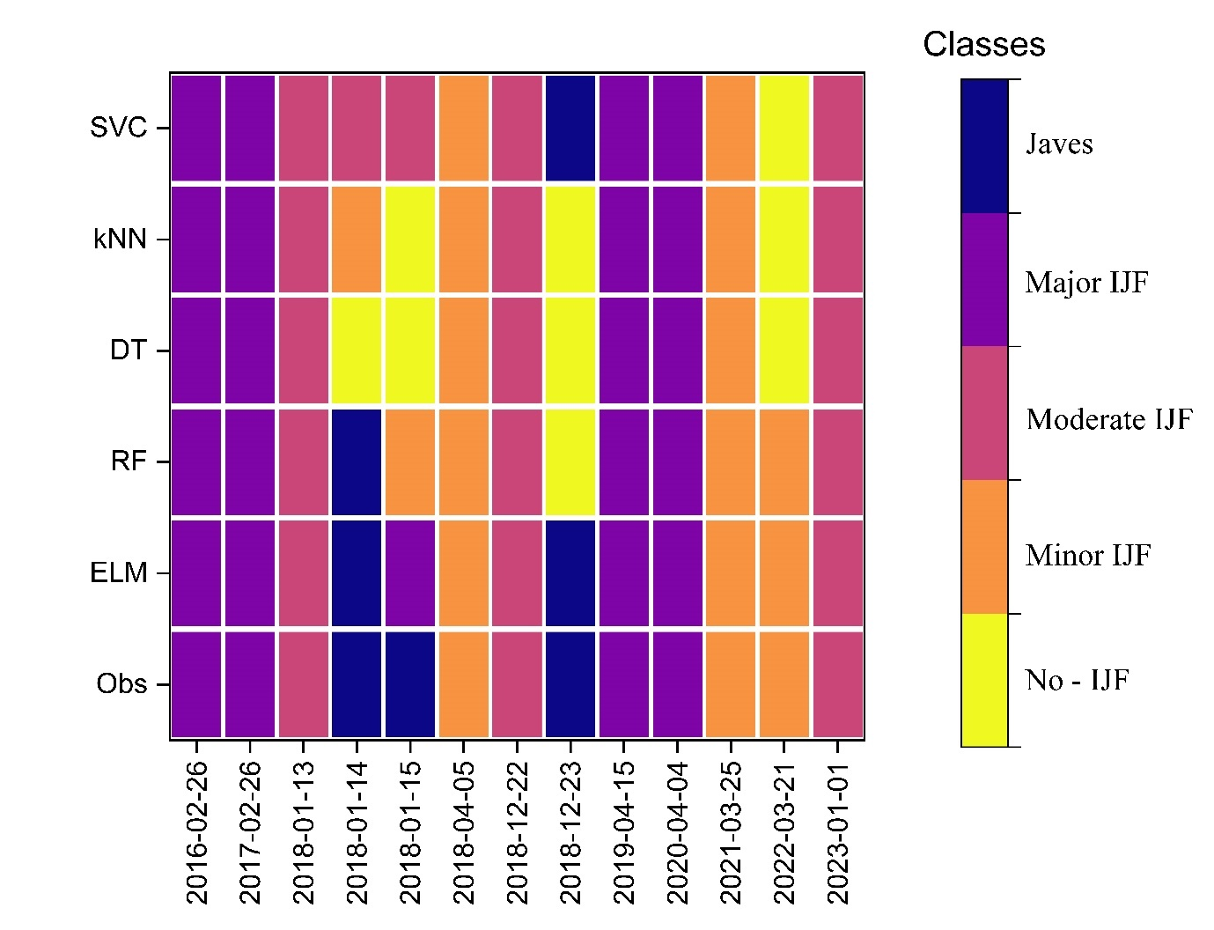
Résultats
E9
Performance par événement
Notes:
Talk about development compare to previous work
Then about JAVE’s performance
Finally data cleaning effect

Slide 27
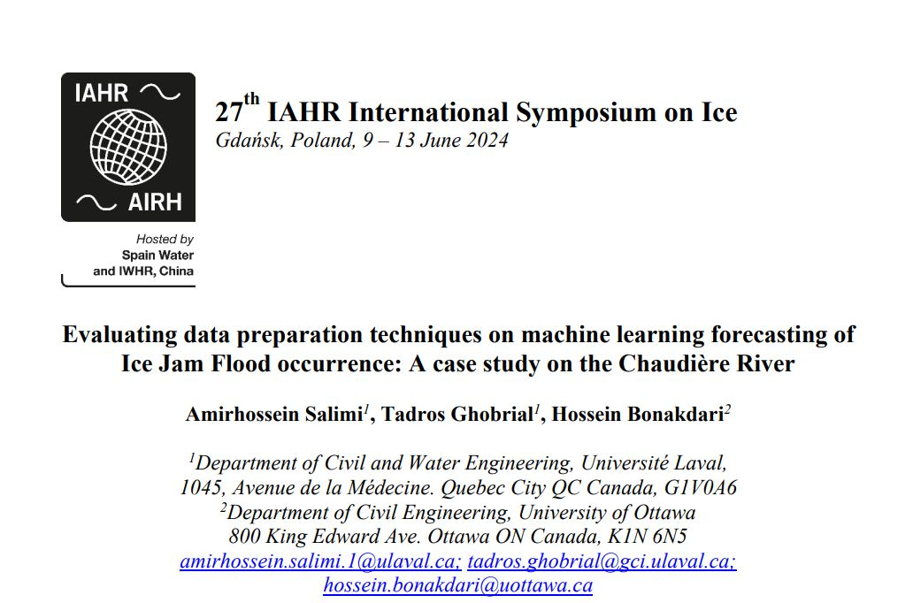
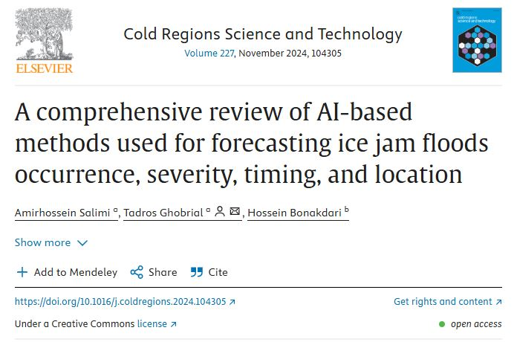
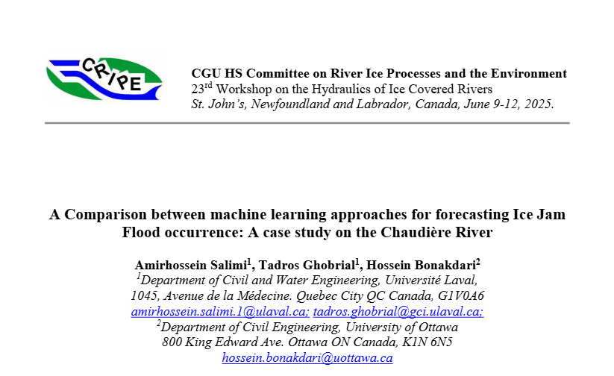
Résultats
E10
Publication

