Slide 1




Estimation, basée sur les modèles, du débit affecté par la glace à partir de mesures hivernales limitées Pattern-based estimation of ice-affected discharge from limited winter measurements
Mohammad Zeynoddin¹*, Tadros Ghobrial¹, Hossein Bonakdari²
¹Département de génie civil et hydraulique, Université Laval, Québec, Canada, mohammad.zeynoddin.1@ulaval.ca, tadros.ghobrial@gci.ulaval.ca
²Département de génie civil, Universite d’Ottawa, Ottawa, Canada, hossein.bonakdari@uottawa.ca
*Correspondence: mohammad.zeynoddin.1@ulaval.ca
Notes:
estimate winter river discharge under ice-covered conditions using limited measurements. The study focuses on the Chaudière River in Quebec and develops data-driven models to improve prediction reliability.”

Slide 2




Introduction
Notes:
Let me start by introducing the topic and why it matters.

Slide 3
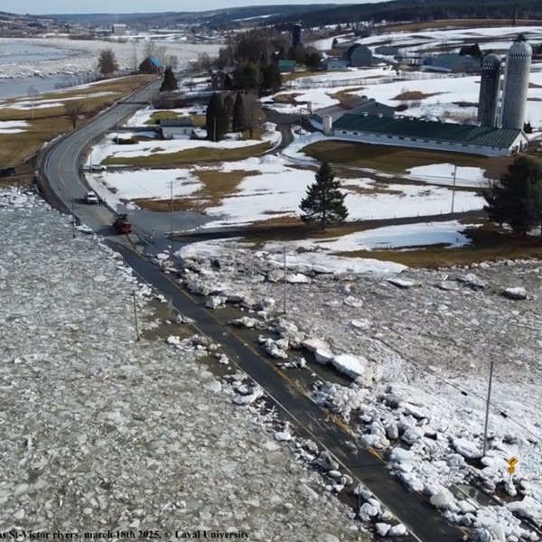

Inondations hivernales au Canada et au Québec Winter Floods in Canada and Quebec
Introduction
La glace modifie la résistance à l'écoulement et masque le débit réel.
Ice alters flow resistance and hides true discharge.
Comprendre l'interaction entre la glace et l'écoulement est essentiel pour la sécurité et l'exploitation.
Understanding ice-flow interaction is key for safety and operations.
Des données de débit fiables sont indispensables pour l'alerte précoce et la gestion des risques.
Reliable discharge data are essential for early warnings and management.
Fig. 1 Effects of tributaries on risk of ice jam flooding near confluences. (From: rivericelab.ca 👉)
Notes:
“Across Canada and Quebec, rivers change dramatically each winter as ice forms. Ice increases flow resistance, raising water levels even when discharge stays the same. When that ice breaks, the sudden release can trigger severe floods. Understanding this interaction is critical for safety, hydropower operation, and effective water management.”

Slide 4
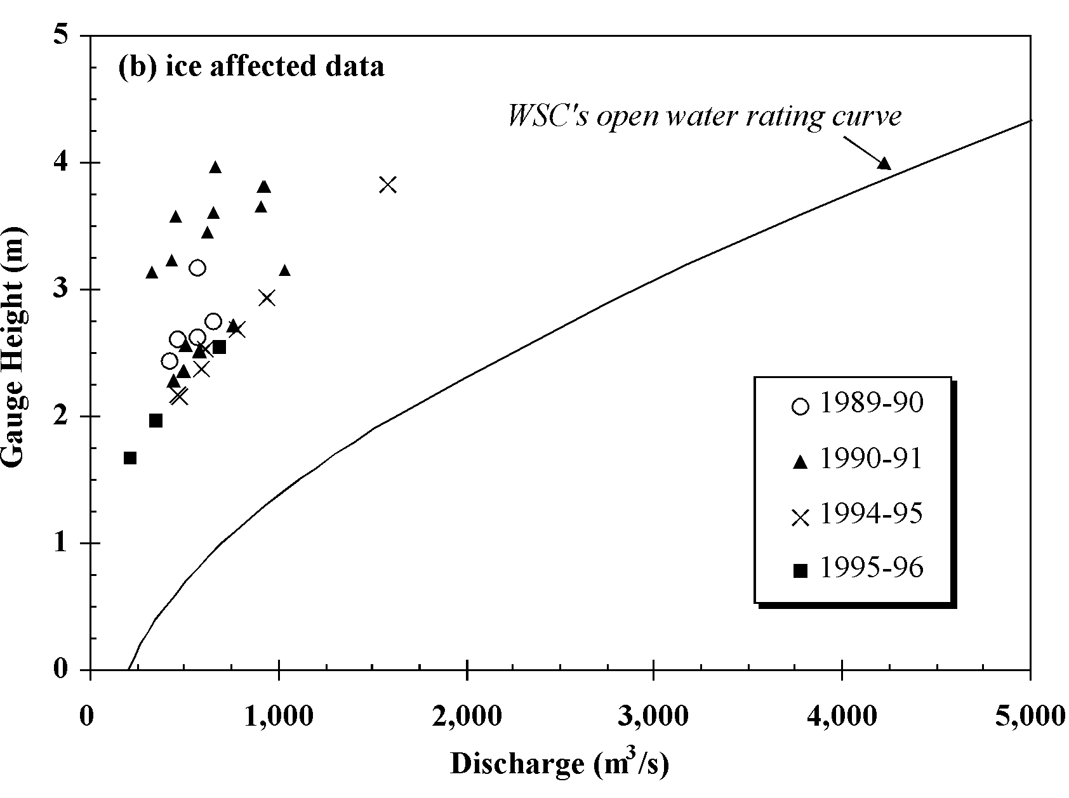
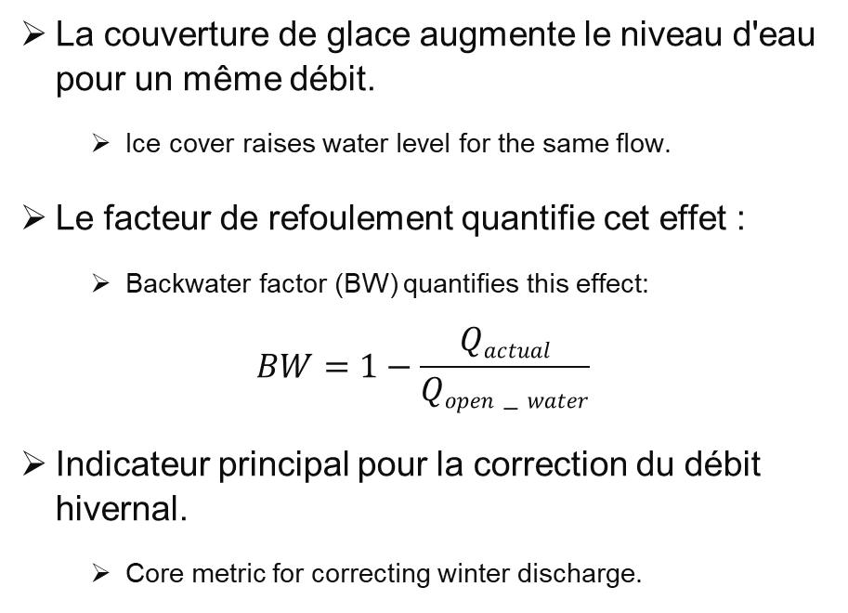
L'effet de refoulement The Backwater Effect
Introduction
La couverture de glace augmente le niveau d'eau pour un même débit.
Ice cover raises water level for the same flow.
Le facteur de refoulement quantifie cet effet :
Backwater factor (BW) quantifies this effect:
$$BW=1−\frac{Qactual}{Qopen−water}$$
Indicateur principal pour la correction du débit hivernal.
Core metric for correcting winter discharge.
Backwater effect caused by ice sheet.
Fig. 2 Ice affected discharge vs. open water discharge on the rating curve (Healy and Hicks, 2003).
Notes:
“When ice forms, it effectively narrows the channel. The water level rises for the same discharge. This phenomenon is called the backwater effect. The backwater factor quantifies how much ice restricts flow and helps correct open-water discharge estimates during winter.”

Slide 5
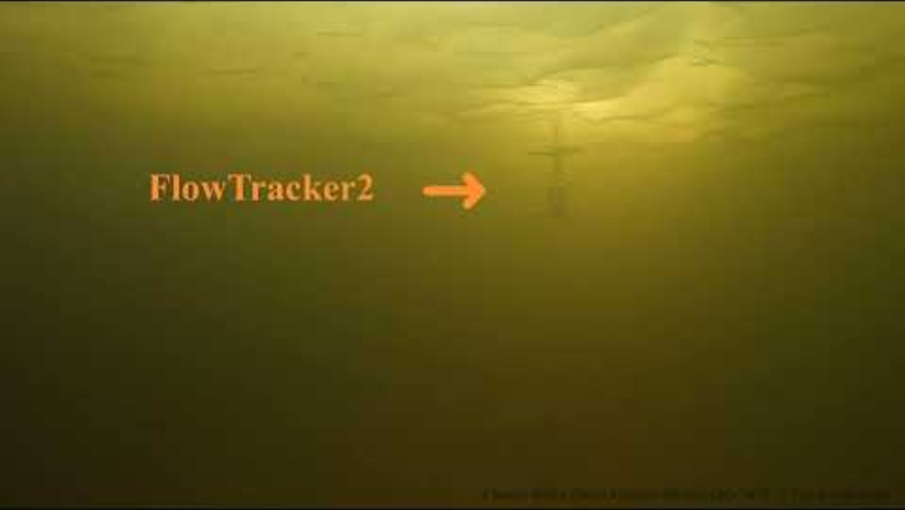
Mesures sous la glace Measuring Under Ice
Introduction
Déversement manuel sous la glace : précis mais dangereux, coûteux et rare.
Manual under-ice discharge: accurate but dangerous, costly, and rare.
Les périodes de dégel et de regel sont souvent non mesurées.
Breakup and freeze-up periods often unmeasured.
Ces lacunes entraînent une incertitude dans les relevés de débit hivernal.
Gaps lead to uncertainty in winter flow records.
Fig. 3 Data collection challenges.
Notes:
Measuring discharge beneath the ice is challenging. Technicians must drill holes and measure velocity manually, which is both dangerous and expensive. As a result, measurements are limited to safe midwinter periods, leaving large gaps during freeze-up and breakup—precisely when hydraulic conditions change fastest.

Slide 6
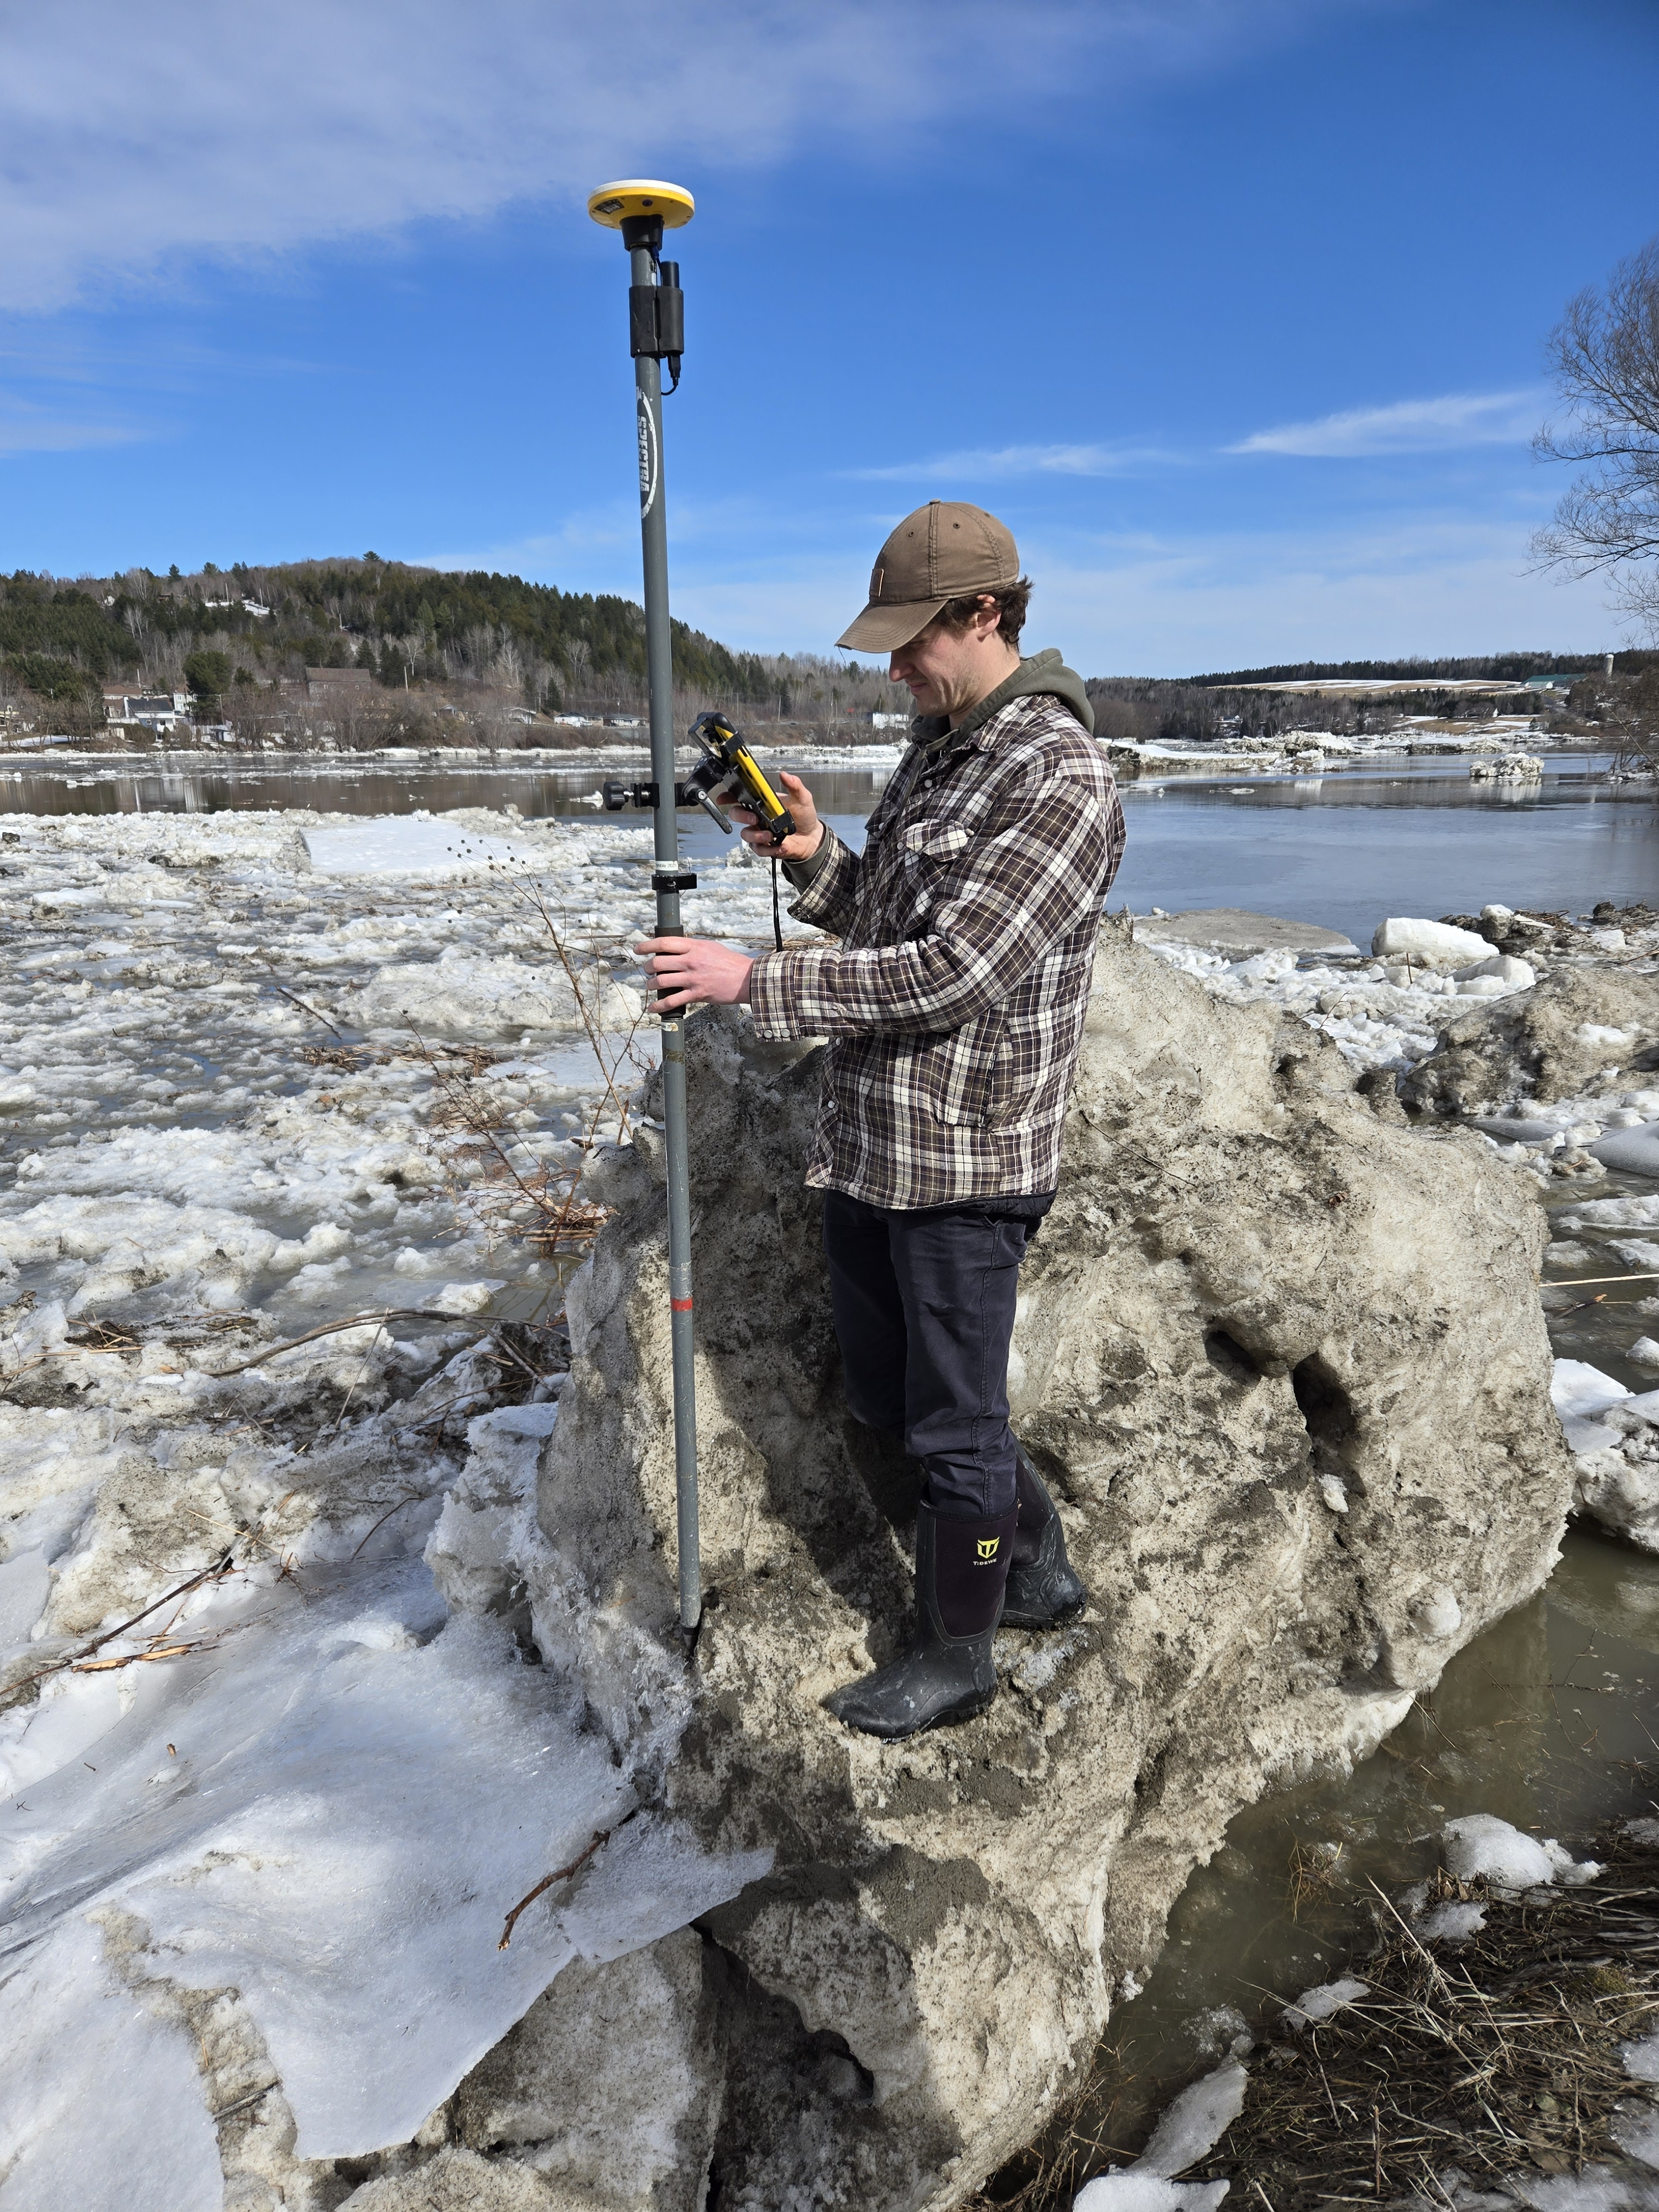
Vue conceptuelle Conceptual view
Introduction
Le manque de données hivernales affecte les prévisions de crues et les modèles hydrologiques.
Missing winter data affect flood forecasting and hydrological models.
Les méthodes opérationnelles reposent sur le jugement d'experts et non sur des règles reproductibles.
Operational methods rely on expert judgment, not reproducible rules.
Langston et al. (2025) ont développé des modèles basés sur des schémas comportementaux pour l'estimation en temps réel à partir du modèle LOESS.
Langston et al. 2025 developed pattern-based models for real-time estimation based on LOESS model.
Le MELCCFP (Québec) et le WSC appliquent le BW au débit Q en eau libre, en se basant sur des mesures physiques et l'avis d'experts.
MELCCFP (Quebec) and WSC: Applying BW factor on open-water Q, based on the physical measurements and experts' decision.
Ces deux projets sont confrontés à la rareté des données et à des défis spécifiques à chaque site.
Both face sparse data and site-specific challenges
Fig. 4 Experts on ice.
Notes:
Because winter data are sparse, current operational methods rely heavily on expert judgment. The Water Survey of Canada and Quebec’s MELCCFP uses backwater factor estimation and rely on the experts’ decision. Some researcher also proposed pattern-based estimation based on local regressions. Both are practical but depend on experience rather than reproducible rules. Our work aims to make this process more systematic and transferable across sites.

Slide 7
Objectifs
Notes:
Now, I’ll walk you through the main objectives of this research.

Slide 8
Objectives
Objectifs de la recherche
Research Objectives Overview
1. Comprendre le comportement des eaux stagnantes
Understand Backwater Behavior
Analyze seasonal BW patterns at Quebec sites.
Reproduce and extend Langston et al. (2025) LOESS approach.
Quantify uncertainty and propose refined models.
Assign the results as benchmark.
2. Explorer la prédiction basée sur les données
Explore Data-Driven Prediction
Develop a machine learning (ELM) framework for BW estimation.
Integrate hydrometric and climatic predictors.
Compare with existing WSC and MELCCFP method and Langston et al. proposed method.
8
Notes:
“This study has two main objectives. First, to analyze backwater behavior and replicate the LOESS-based seasonal patterns across Quebec sites. Quantify the model accuracy and set it as a benchmark model.
Second, to develop a data-driven alternative using a suitable machine learning method that predict backwater directly from hydrometric and climate variables and Compare with benchmark model. Together, these approaches bridge physical insight and modern machine learning.”

Slide 9
1
2
3
4
5
6
Méthodologie

Slide 10
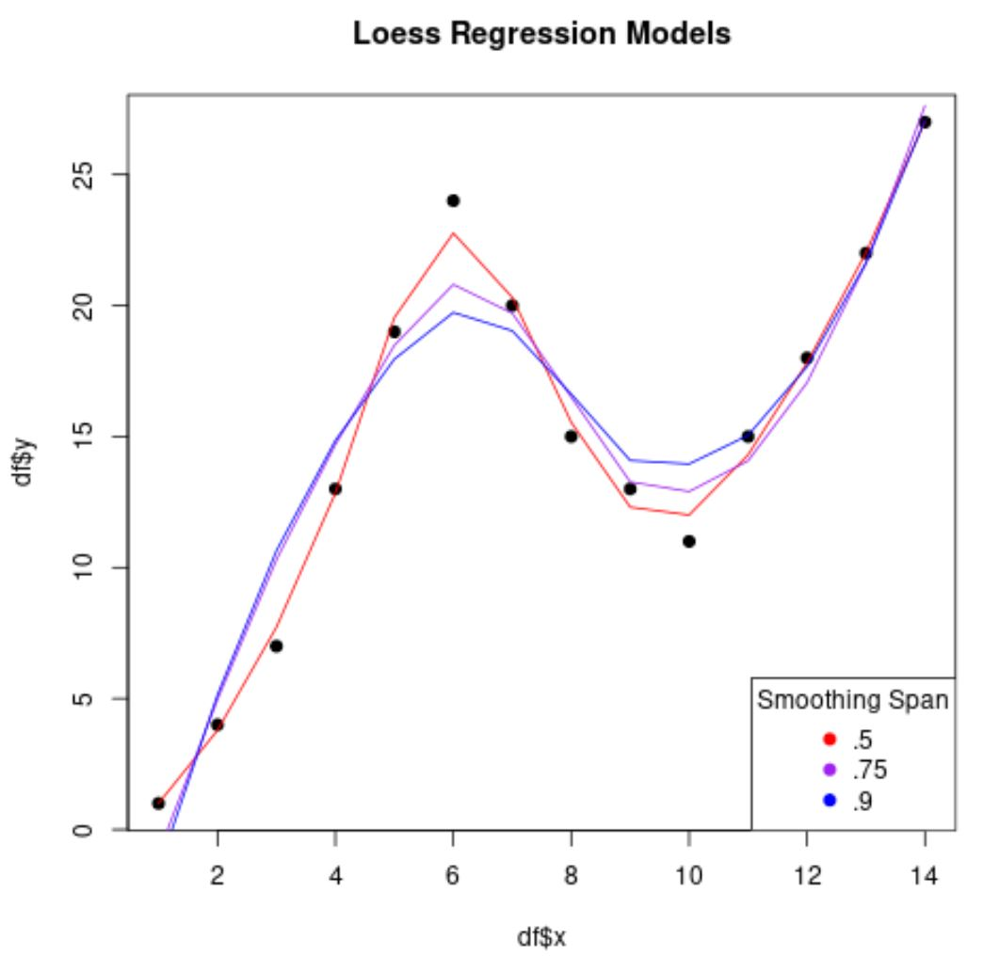
Méthodologie
Cadre de modélisation LOESS
LOESS Modeling Framework
2
3
4
5
6
1
Régression locale non paramétrique.
Capture les variations saisonnières et régulières du poids corporel.
Pondération par la date de dernière intervention pour une meilleure adaptabilité.
Simple, interprétable et spécifique au site.
Nonparametric local regression, Captures smooth, seasonal BW variations.
Weighted by recency for adaptability, simple, interpretable, but site-specific
Fig. 5 How to Perform LOESS Regression in R (With Example) by Zach Bobbitt
10
Notes:
LOESS, or locally estimated scatterplot smoothing, models backwater as a smooth curve through time without assuming a fixed functional form. It fits many small local regressions, which together trace the seasonal behavior—from the sharp rise during freeze-up to the decline at breakup. We assign more weight to recent years so the model reflects evolving climatic patterns. The result is a clear seasonal signature for each station, interpretable yet data-driven.

Slide 11
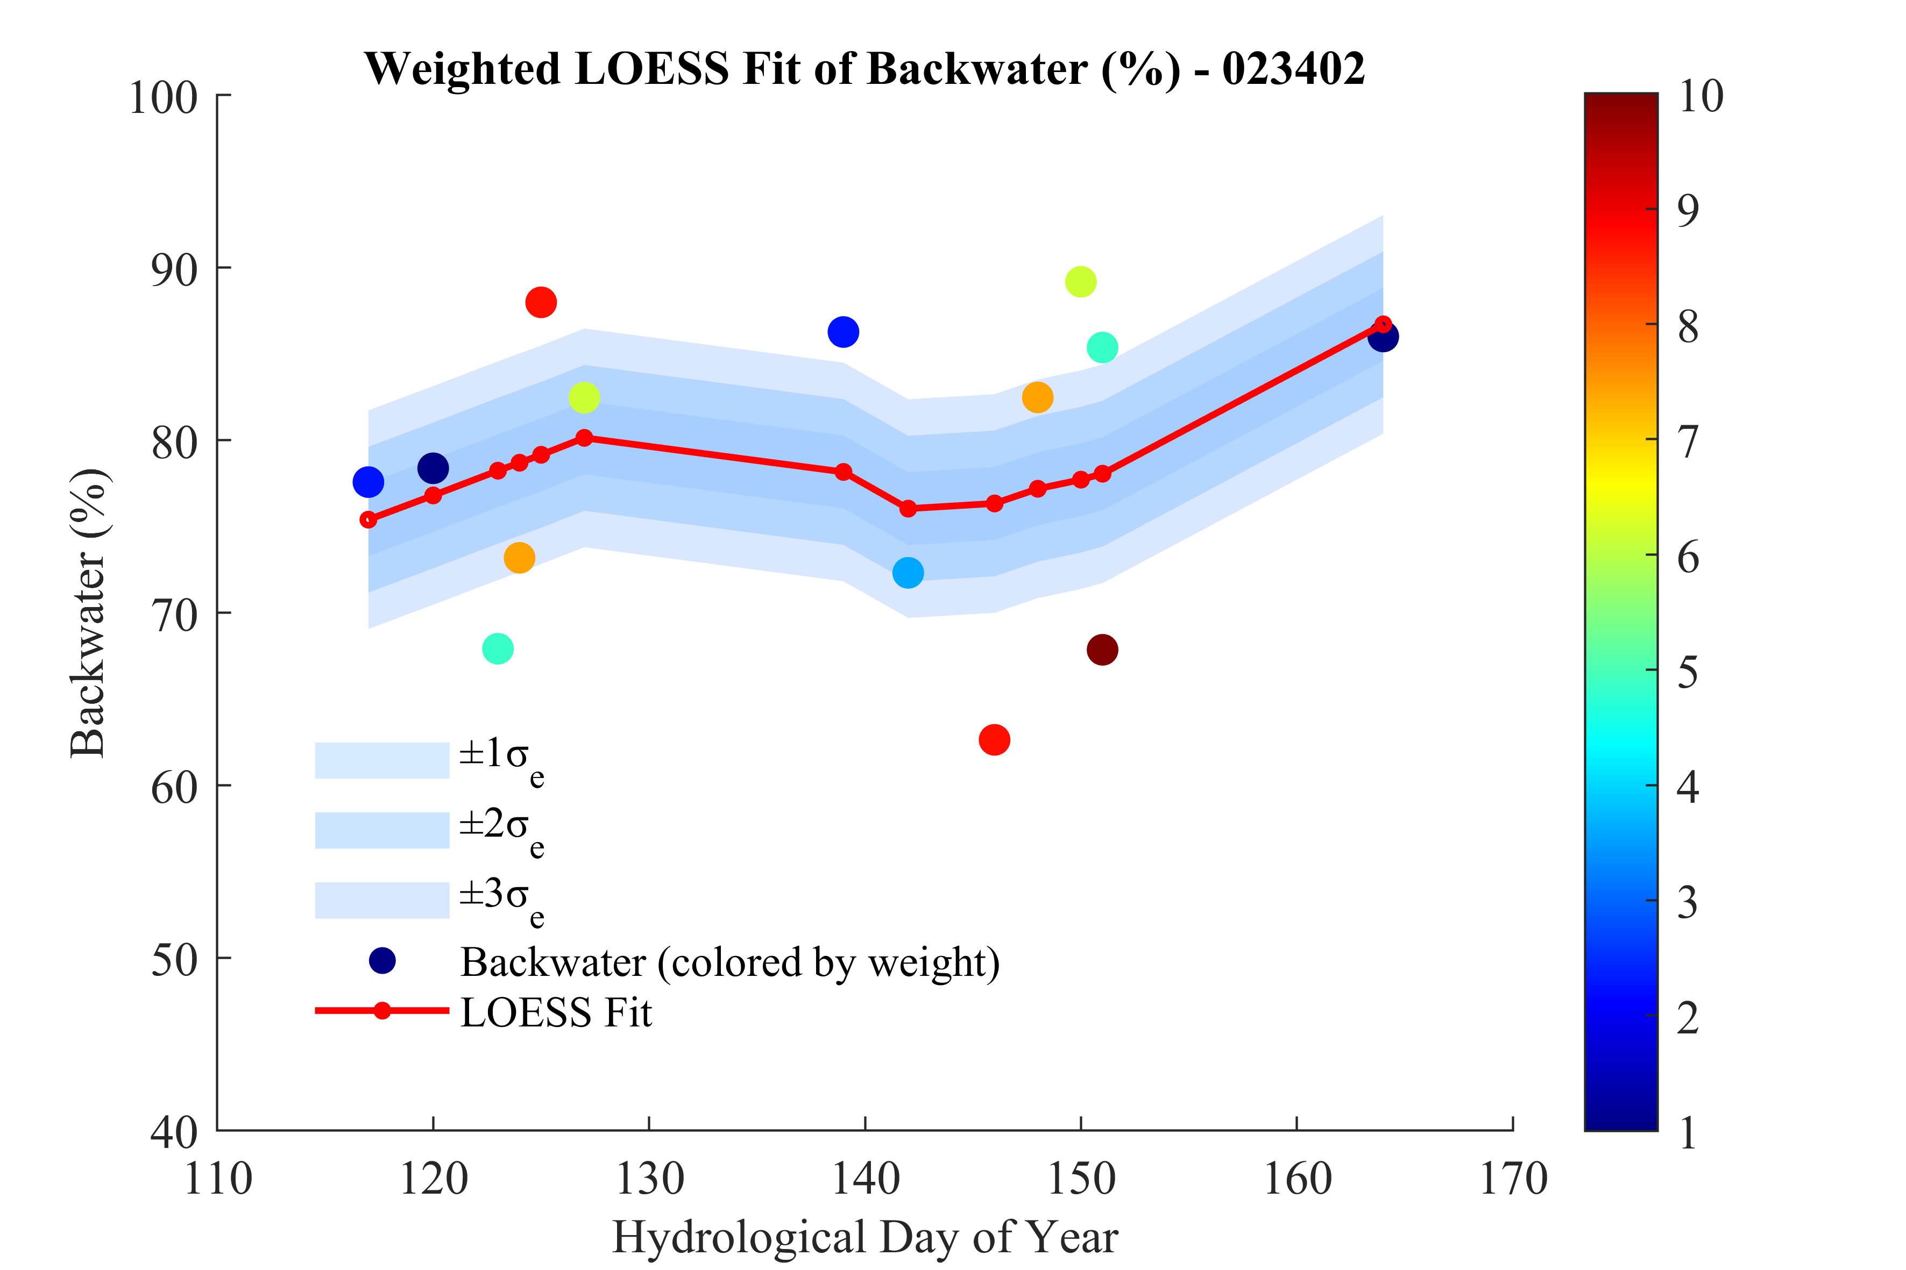
Méthodologie
Validation et analyse d'incertitude de LOESS
2
3
4
5
6
1
LOESS Validation and Uncertainty Analysis
Modèle testé avec des années exclues (recherche par grille).
Résidus rééchantillonnés pour obtenir des intervalles de prédiction à 95 %.
Test de sensibilité réalisé sur la durée de la période, l'ordre du polynôme et la pondération.
Approche améliorée : durée locale adaptative pour capturer les transitions.
Model tested with withheld years (grid search).
Residuals resampled to derive 95% prediction intervals.
Sensitivity tested for span, polynomial order, and weighting.
Refined approach: adaptive local span to capture transitions.
Fig. 6 Uncertainty definition for LOESS Regression.
11
Notes:
To verify model robustness, we withheld individual years from fitting and tested predictive accuracy on unseen winters. This cross-season validation revealed that uncertainty increases during early freeze-up and late breakup, when hydraulic conditions shift rapidly. We used residual resampling to quantify prediction uncertainty and derived 95% confidence intervals.

Slide 12
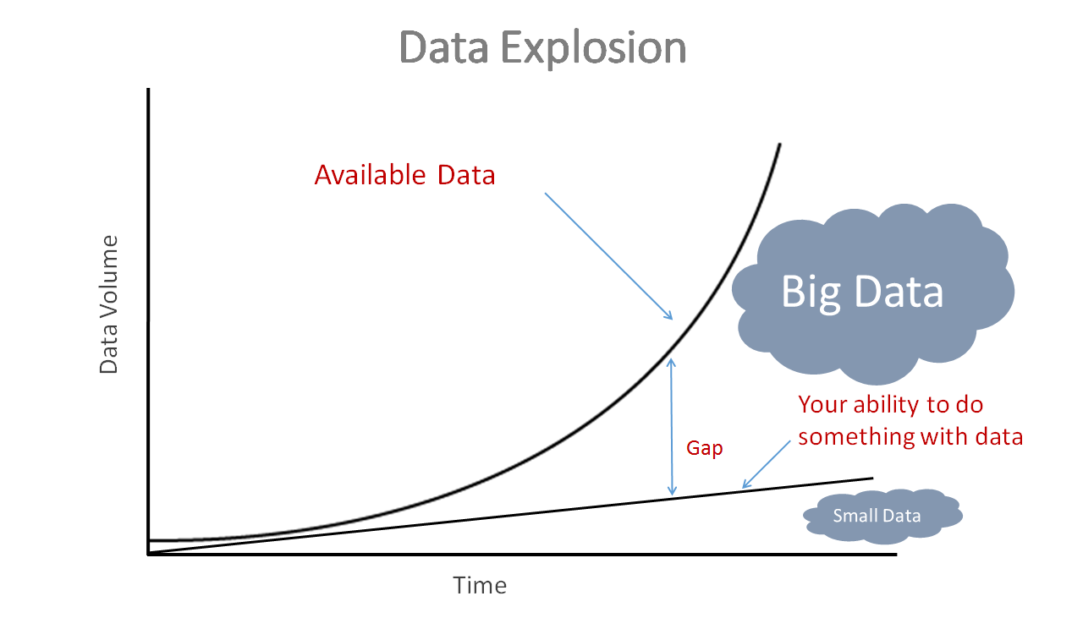
Méthodologie
5
6
1
2
Explorez les prédictions basées sur les données
Explore Data-Driven Prediction
Lorsque les données sont rares
When Data Are Scarce
Peu de mesures, forte variabilité.
Few measurements, high variability.
Nécessité de modèles robustes et compacts.
Need robust, compact models.
Combiner compréhension physique et flexibilité statistique.
Combine physical insight with statistical flexibility.
12
Fig. 7 Handling Big Datasets for Machine Learning, by Matthew Stewart, PhD
Notes:
With just a handful of winter measurements per site, standard statistical models fail. We need methods that can learn from limited, noisy data without overfitting. That’s where the ELM comes in—a minimalist neural model designed for simple-structured learning while preserving interpretability.

Slide 13
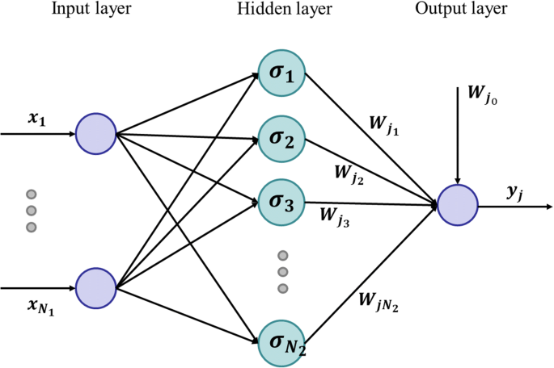
Méthodologie
2
3
4
5
6
1
2
La machine d'apprentissage extrême
The Extreme Learning Machine
Couche cachée unique, entraînement rapide, poids de sortie analytiques.
Single hidden layer, fast training, analytical output weights.
Pas de rétropropagation, pas d'optimisation itérative.
No backpropagation, no iterative tuning.
Fonctions d'activation : sigmoïde, tangente etc..
Activation functions: sigmoid, tanh, sine, radial basis, triangular.
Recherche par grille pour le nombre de neurones et le type d'activation.
Grid search for neuron count and activation type.
Fig. 8 ELM network. (From: Wang, et al. 2022).
13
Notes:
The Extreme Learning Machine is like a neural network stripped of unnecessary complexity. Input weights are random, the hidden layer is fixed, and the output layer is solved analytically. It’s fast—training thousands of models in minutes—and effective for structured but limited datasets like ours. By varying activation functions and network size, we can identify the most stable configurations.

Slide 14






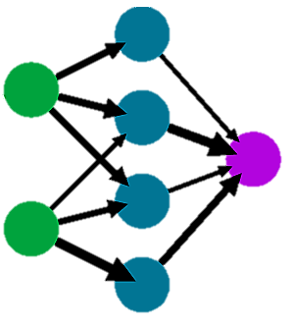
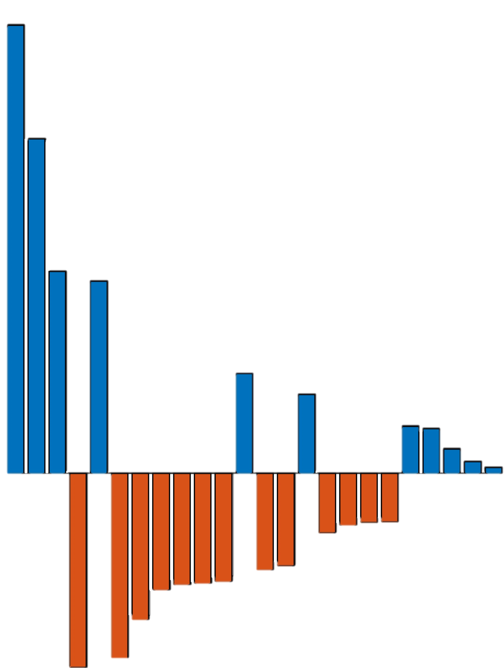


Méthodologie
Start Mapping Process
2
3
4
5
6
1
2
Pipeline de modélisation
Target Selection & Dataset preparation
Modeling Pipeline
External inputs selection
Modeling strategy definition
Normalize data (0–1 scale).
Train/test split and 3-fold cross-validation.
1,000 random initializations per fold.
Evaluate R, RMSE, MAE, AIC.
Filter models by stability and consistency.
Rank by lowest AICc.
Reassess Entire Workflow
Environmental Factor Integration
Dataset Normalization
ELM Modeling
Feedback Loop
Input Analysis
Mapping and evaluation
Reanalysis
Methodology Evaluation
14
Fig. 9 Flowchart.
Notes:
Our workflow tests thousands of candidate networks through systematic cross-validation. Each model is trained on two folds, validated on the third, and repeated a thousand times with random starts. We then filter models for internal consistency—stable error, balanced train-test performance—and finally rank them using the corrected Akaike Information Criterion, which rewards simplicity and penalizes overfitting.

Slide 15
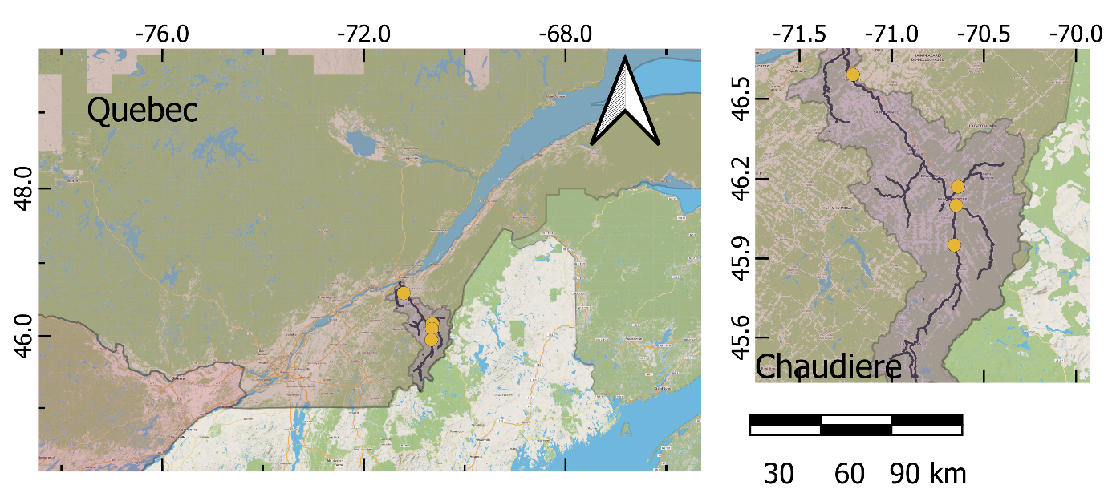
Méthodologie
Zone d'étude
Study Area
4
Stations:
Quebec:
1. St Martin, 2. St George,
3. Famine, 4. St Lambert,
Period: 2015–2025 winter seasons.
Manual measurements:
débit sous la glace → équivalent en eau libre → Le facteur de refoulement.
under-ice discharge → open-water equivalent → backwater factor (target).
3
2
1
Fig. 10 Location of study basins (Chaudière).
15
Notes:
This step of our study covers the Chaudière River system in Quebec, which includes the Famine, St-Martin, and St-Georges stations. This spatial spread allows us to explore how regional climate and river morphology influence ice development and backwater effects.
Each of the 4 hydrometric stations provided multi-year winter records, including manual under-ice discharge measurements and automatic water levels records. These were converted to open-water equivalents and then used to compute the backwater factor, which serves as our primary modeling target.

Slide 16
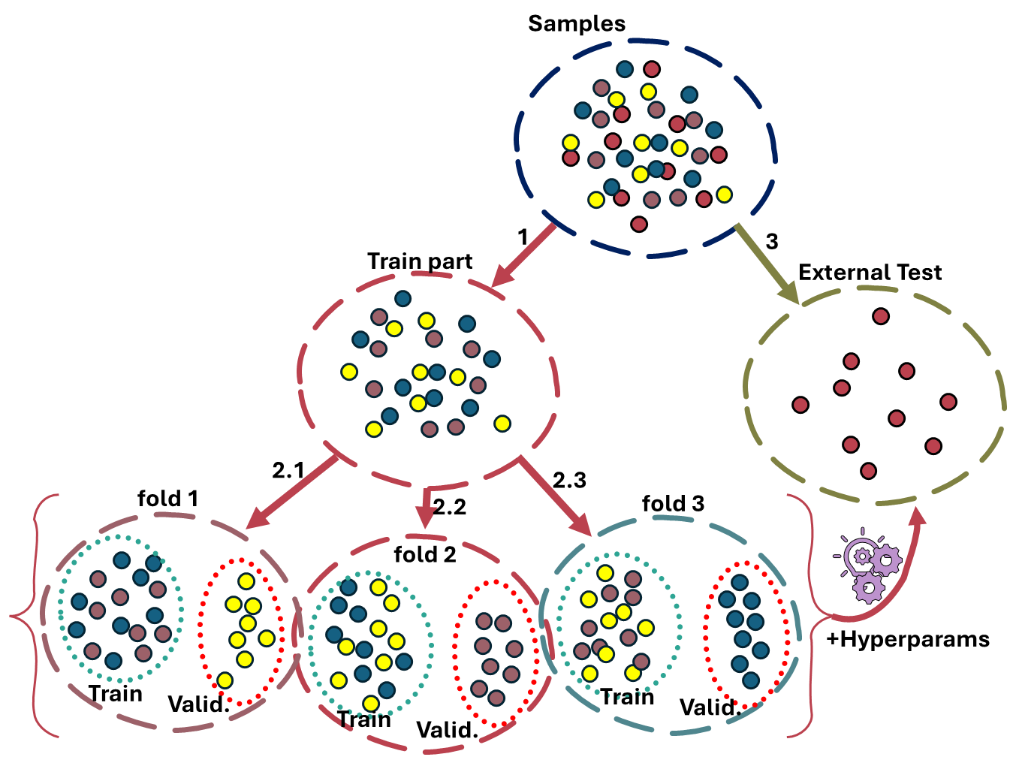
Méthodologie
Ensemble de données
Dataset
Partitionnement des données et entraînement du modèle :
Entraîner et optimiser le modèle par validation croisée à 3 plis (environ 75 % des échantillons).
Tester le modèle sur un jeu de données externe (environ 25 % des échantillons restants).
Data partitioning and model training:
Train and tune the model with a 3-fold cross-validation approach (~75% of samples)
Test on an external dataset
(~25% remaining samples)
Fig. 11 3-fold cross validation training and external test.
16
Notes:
To train the model network, we separated the dataset to two parititions as train and external test.
Then to train the model, we further separated the train partition into 3 subgroups as folds 1 to 3, which helped us to find the optimum hyperparameters and activation functions for each site.
Finally, we tested the optimum values on the external test partition.
This process gives us a reliable model performance evaluation and uncertainty quantification.

Slide 17
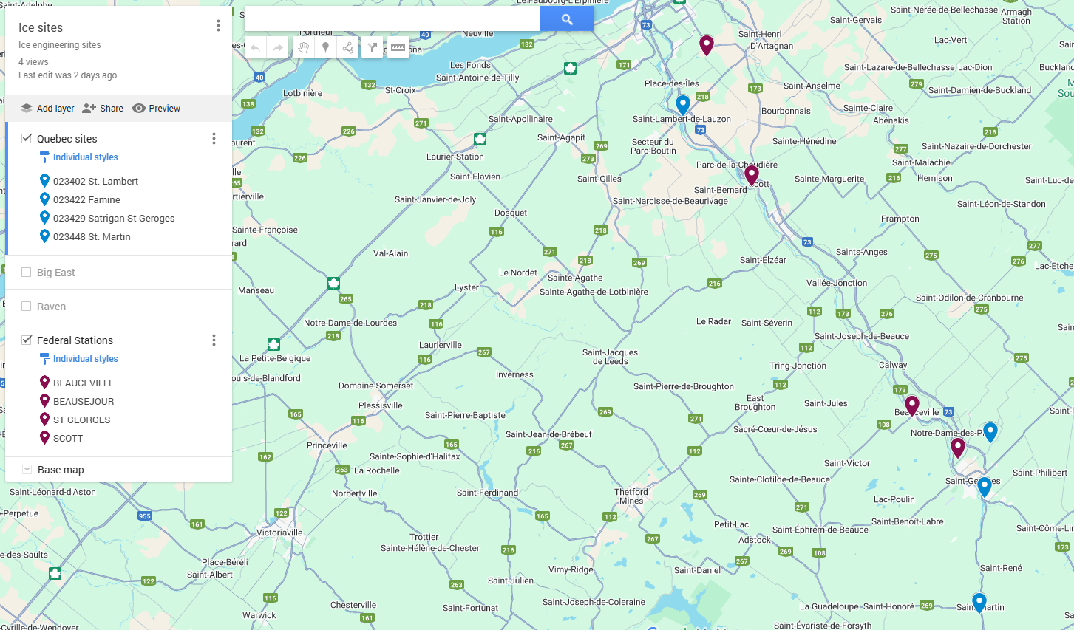
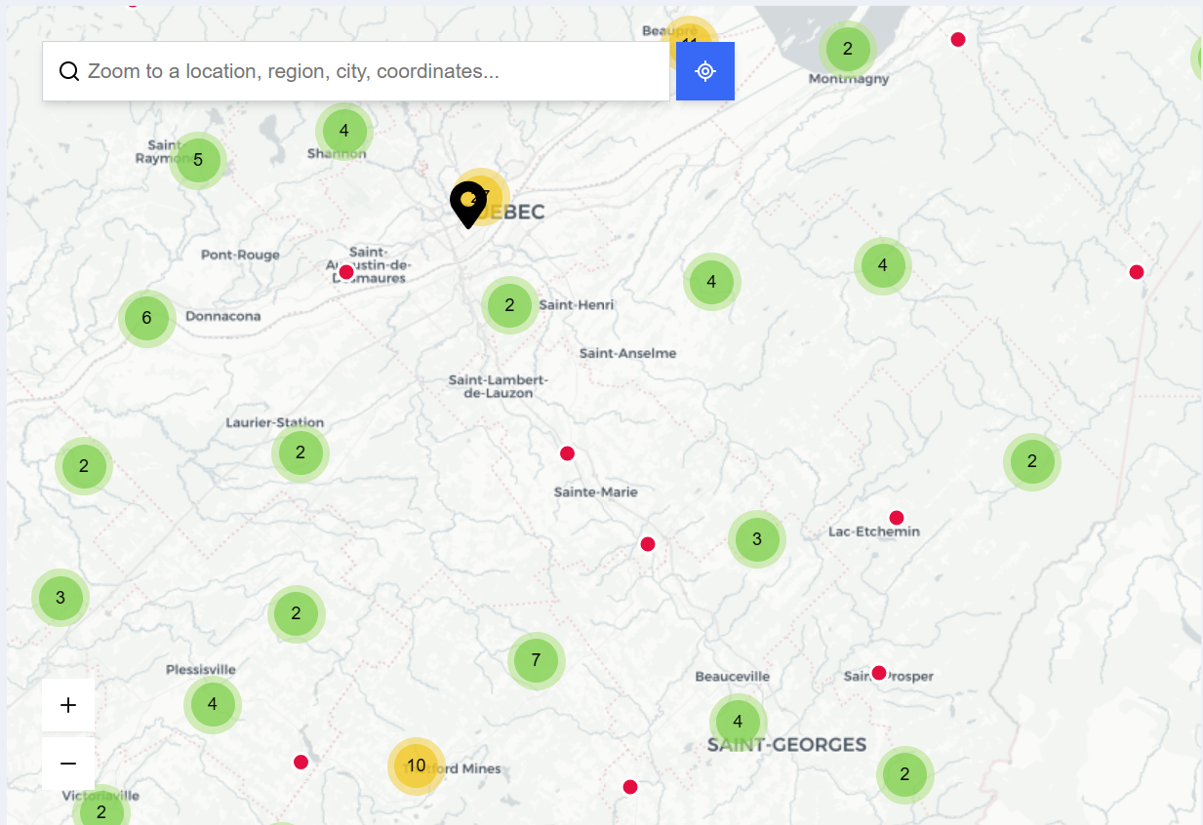
Méthodologie
Ensembles de données météorologiques
Weather Datasets
Water Level
radiation
wind
precipitation
snow
temperature
seasonality
Stations météorologiques au Québec : Stations disponibles au Québec pour les données climatiques sur le site Web d'Environnement Canada
Weather stations in Quebec: Available stations in Quebec for climate data on the website of Environment Canada
17
Fig. 12 Weather stations in Quebec.
Fig. 13 External factors.
Notes:
To collection input dataset we searched for the available climate data from weather stations near target sites, to see if we can model BW with available data on environment Canada website. The weather stations were limited and the data were incomplete. So, we had to interpolate the missing values and increase the quality of the inputs.

Slide 18
Résultats et conclusion

Slide 19
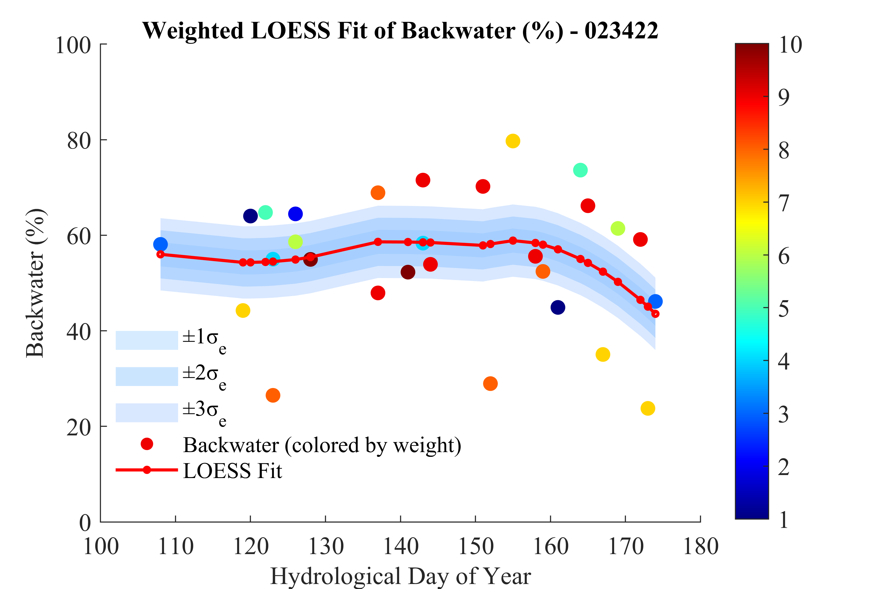
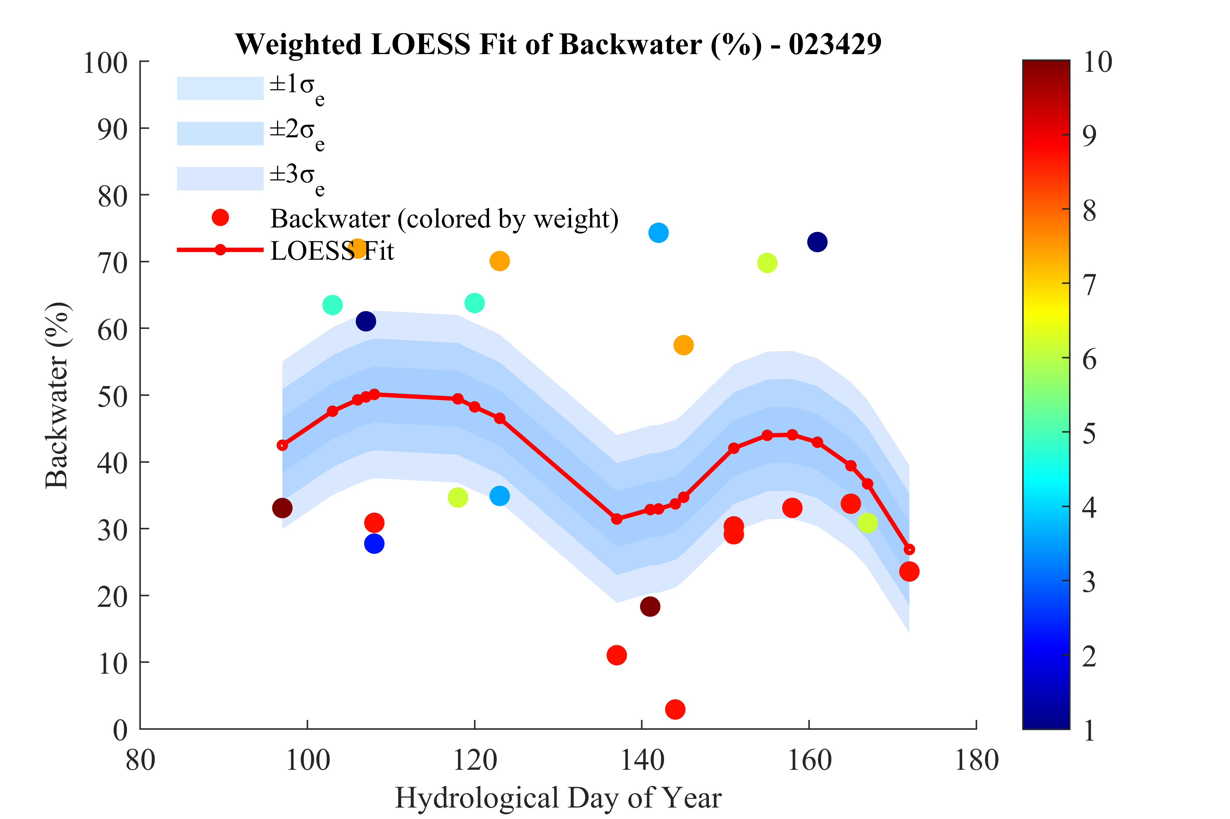
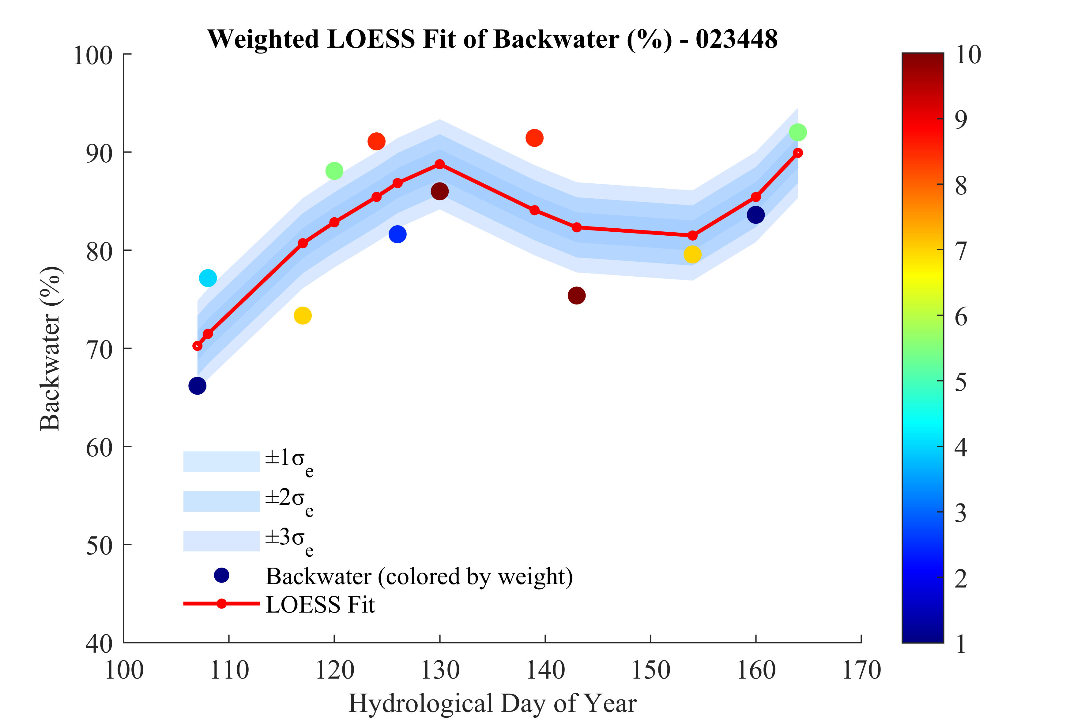
Résultats
2
Modélisation LOESS
Québec
3
4
5
6
1
Les tendances sont similaires d'une station à l'autre, mais le calendrier varie.
Saint-Martin et Saint-Lambert présentent une plus grande variabilité.
Les lacunes dans les données expliquent les marges d'incertitude plus importantes.
Fig 14. Fitted LOESS, weighted based by recency from 1 to 10; Oct. 1st = Day 1 of the hydrological year.
19
Notes:
After testing different model parameter, we found the 60 to 80 span works well for loess modeling and it was close to the value reported for the benchmark model study. Therefore, the 70% span, with weighting by recency to a maximum wight of 10 similar to the other study, was chosen to generate the patterns and loess model, as you see here.
In the 4 plots, you can see the fitted LOESS curves and after comparison with the other study on alberta and Ontario sites we found similar behavior.
The Quebec sites show the same midwinter plateau and freeze-up rise, with a slight shift in timing.

Slide 20
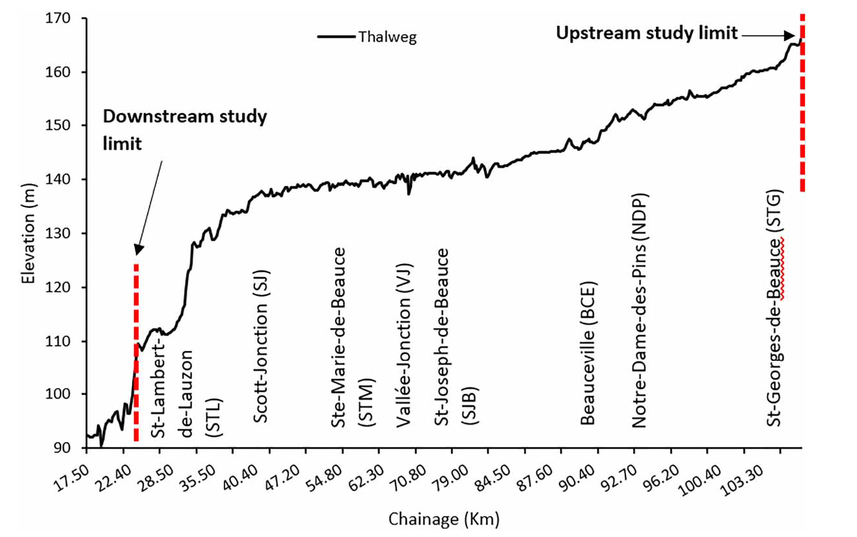
Résultats
2
3
4
5
6
1
Effets de la géographie et des variations climatiques associées
St-Martin
St. Lambert
Effect of geography and associated climate variations
St. Famine
L'altitude et la pente influencent fortement l'amplitude du courant de fond.
Des chenaux plus pentus entraînent un courant de fond plus faible.
Courant de fond = F(géo + climat +…)
St. Georges
St. Famine
Fig. 15 Discharge and backwater = F(elevation and Bed slope); (From: Ladouceur, et al. (2023). https://doi.org/10.2166/nh.2023.201)
20
Notes:
Based on the graphs, we can also tie the behavior to the geographical coordination and associated climate variations. For example this graph shows the evaluation of the chaudiere river only for st George, and st lambert.
We observe that elevation and bed slope strongly influence the backwater factor, linking hydraulic geometry to ice resistance.

Slide 21
Résultats
2
3
4
5
6
1
2
Explore Data-Driven Prediction
ELM result on Weather stations dataset
BW%
1.HDOY
4.T_PRCP
3.Max Temp
5.T_RAIN
6.T_SNOW
7.SNOW_OG
2.Min Temp
Recherche exhaustive par grille sur les entrées et les configurations de modèles :
Nombre total de modèles étudiés : 38 250
Issus de la combinaison des éléments suivants :
Nombre de neurones
Fonctions d’activation
Combinaisons d’entrées
MIN_TEMP | Max TempDefinition | °C
MAX_TEMP | Min TempDefinition | °C
T_PRCP | Total PrecipDefinition | mm
T_RAIN | Total RainDefinition | mm
T_SNOW | Total SnowDefinition | cm
SNOW_OG | Snow on GrndDefinition | cm
21
Fig. 16 Inputs chart.
Notes:
Based on the collected 6 climate data from environment Canada website for Quebec, we performed an extensive grid search to find the best input for the sites totaling 38k models for each site.

Slide 22
Résultats
2
3
4
5
6
1
2
Résultats de la validation croisée et de l'évaluation externe
Cross-Validation and external assessment results for all Quebec sites
Average LOESS R = 0.16
Fig. 17 ELM performance evaluation.
22
Notes:
Here you can see the best model results for each site based on the 3 metrics of R, MRSE and MAE for cross validation mean indices and external validation.
In general the accuracy was good with a correlation around 90% on average and errors less than 10% for the ELM model.
The last column bar in each chart also shows the LOESS quantified accuracy. The correlation for this model was around 16% on average and the errors were considerably higher than ELM.

Slide 23
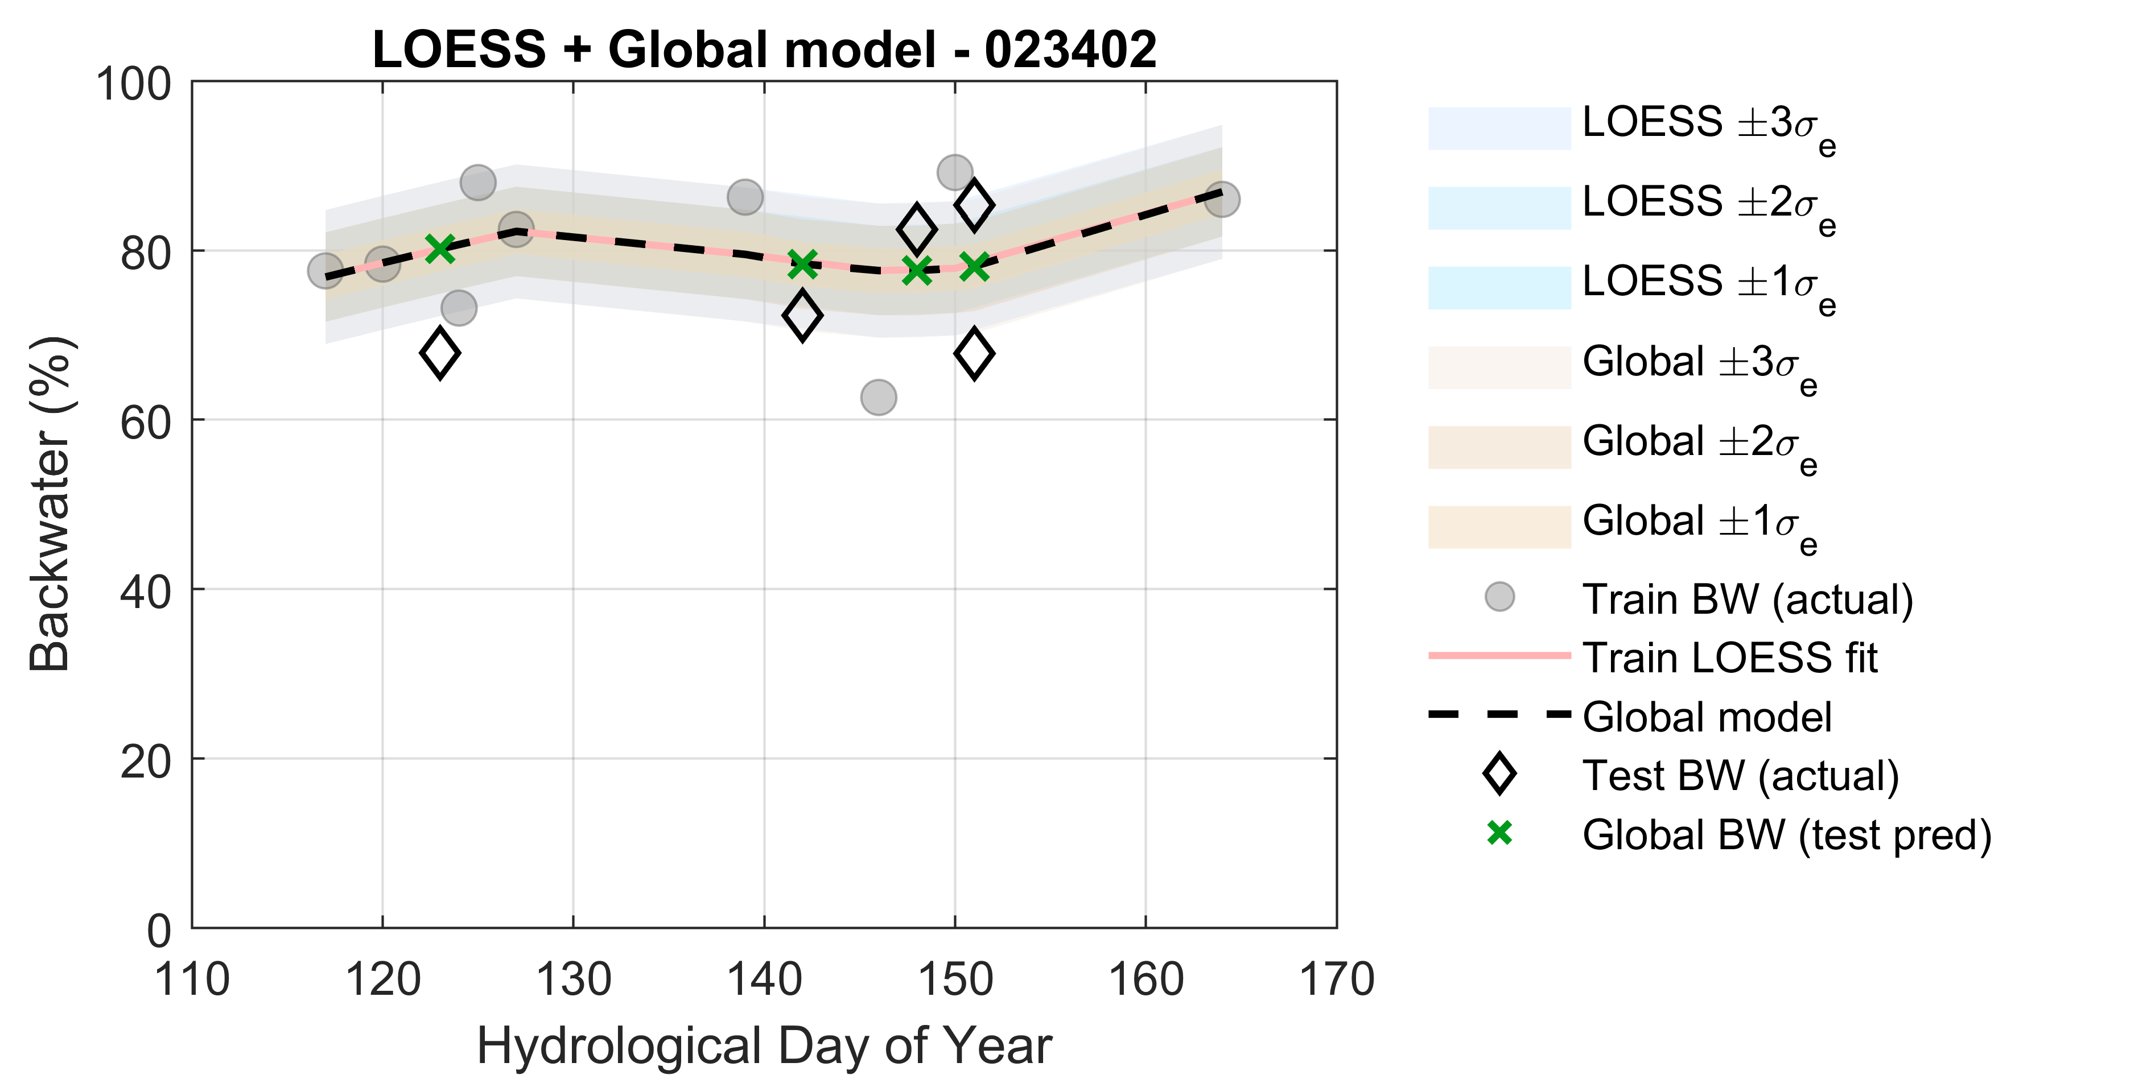
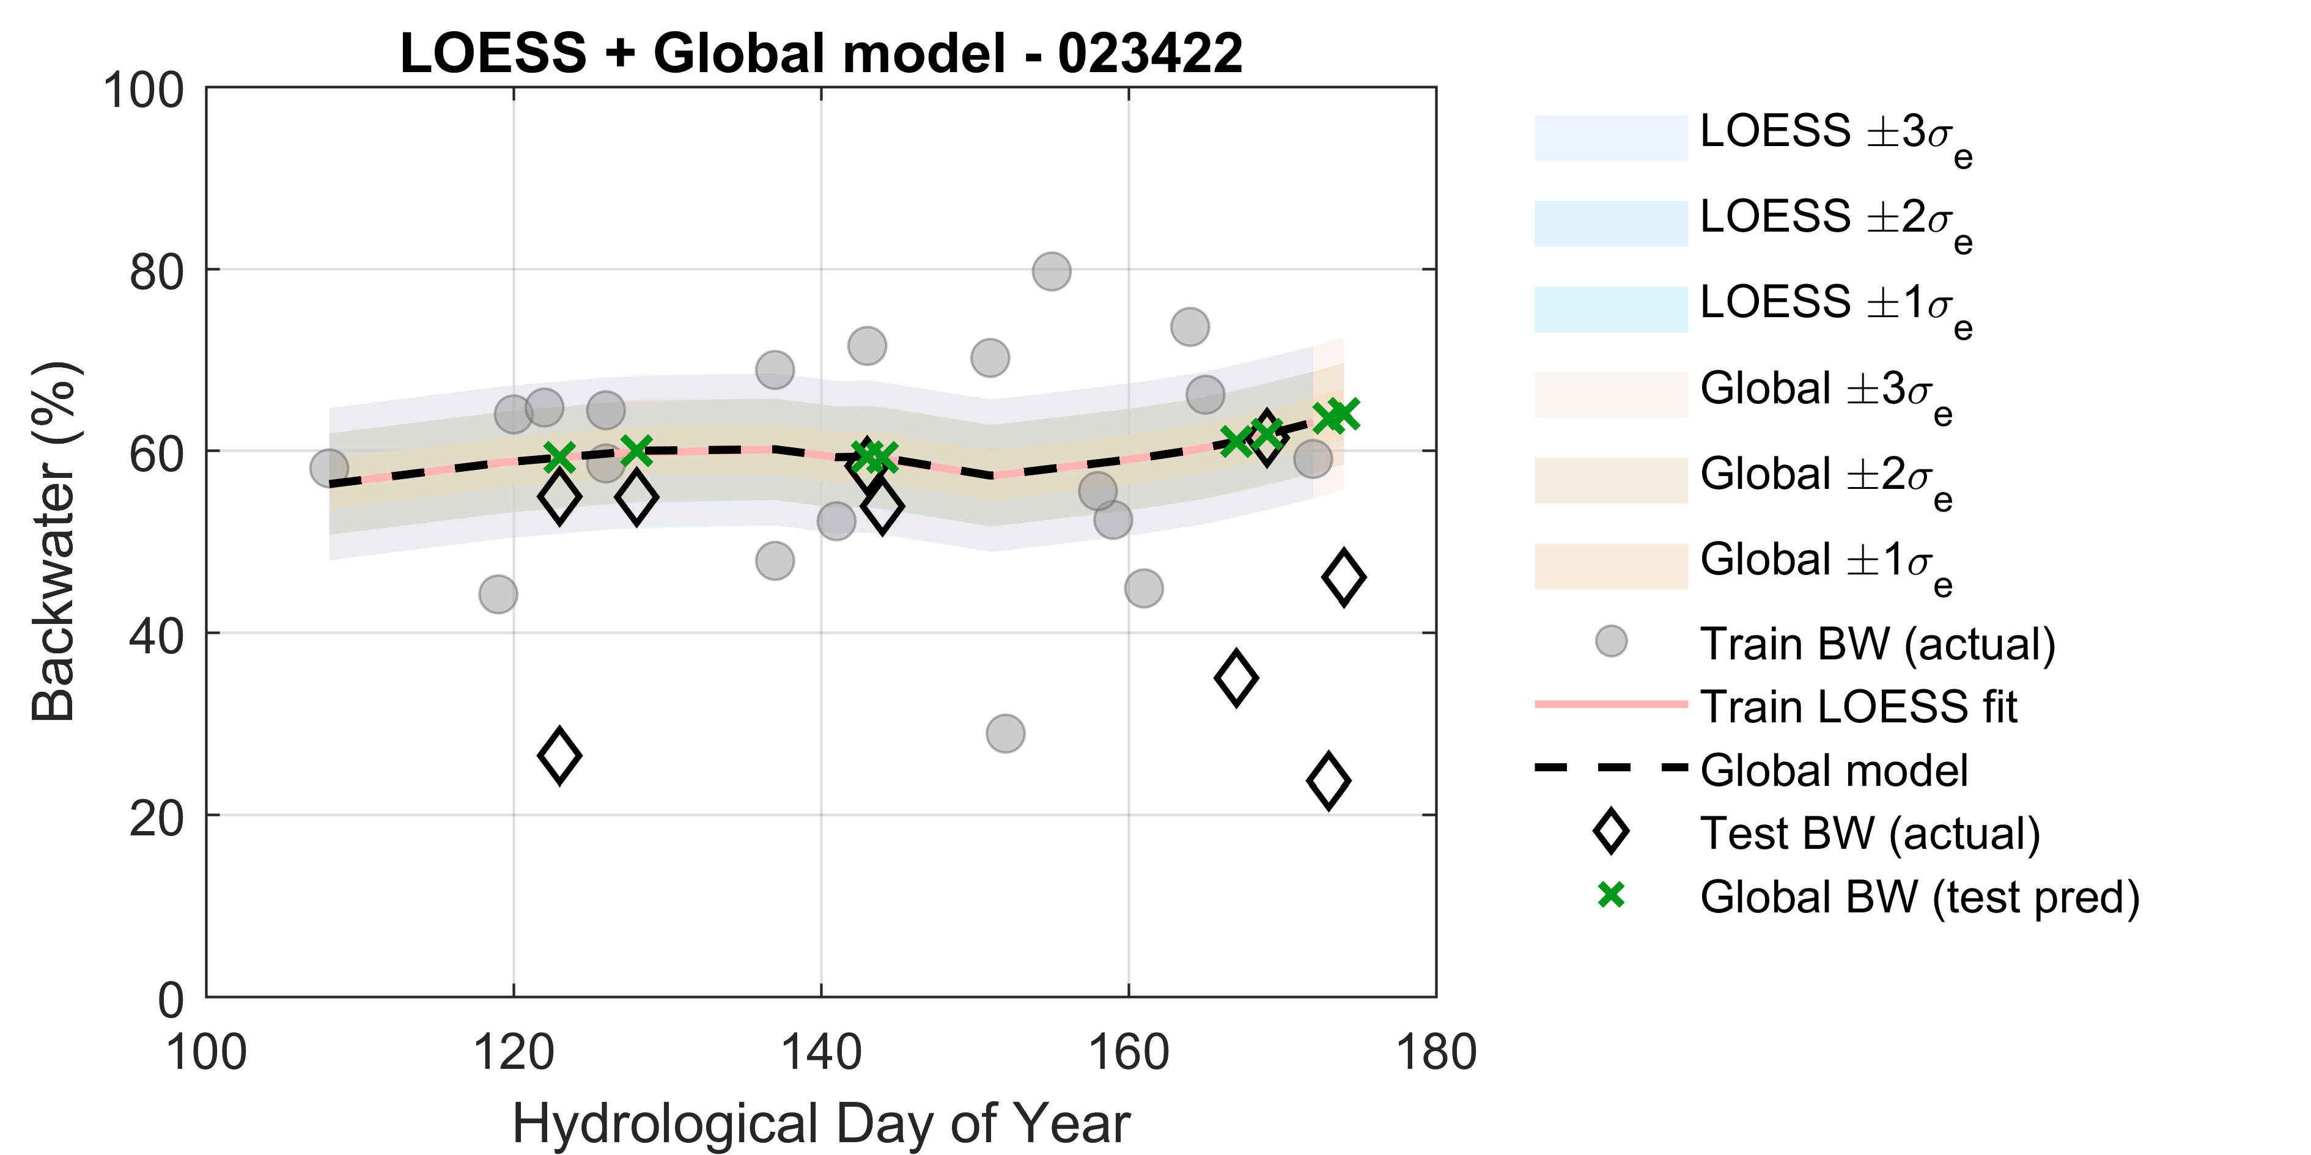
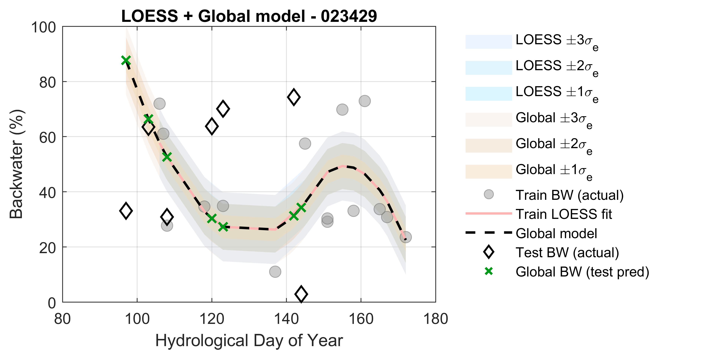
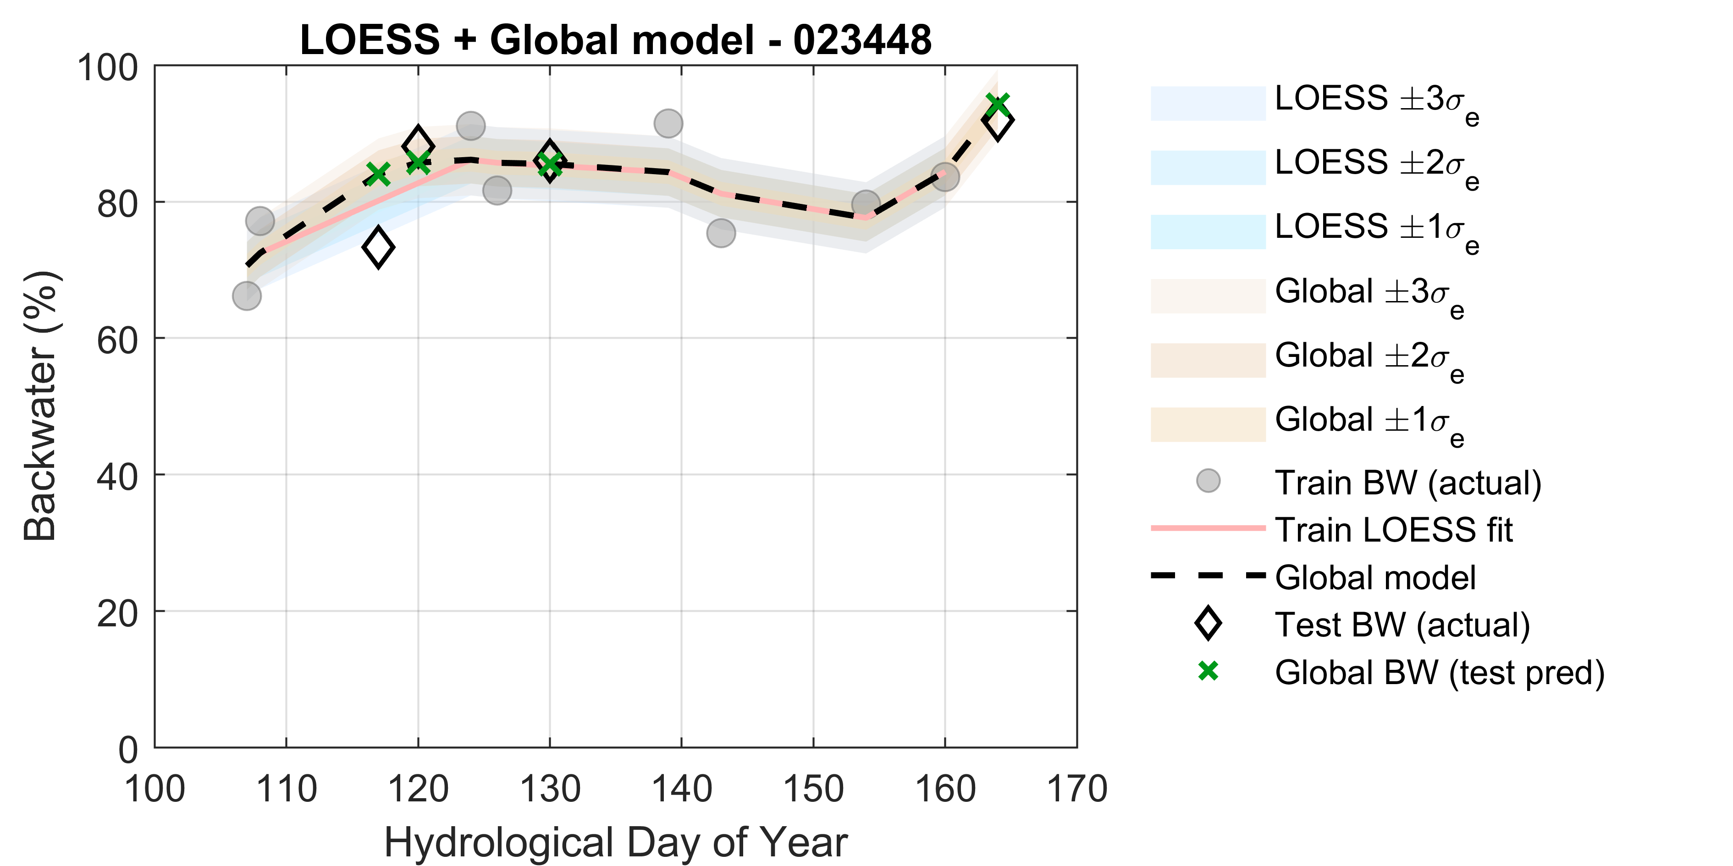
Résultats
Lambert
Famine
2
3
4
5
6
1
2
LOESS
Georges
Martin
Fig. 19 LOESS scatters.
Notes:
As mentioned earlier, loess is intensely dependent to datasize and scatterness. So, when we have samples outside the predicted pattern as you see in left chart, we should extrapolate the pattern which reduces the accuracy considerably.

Slide 24
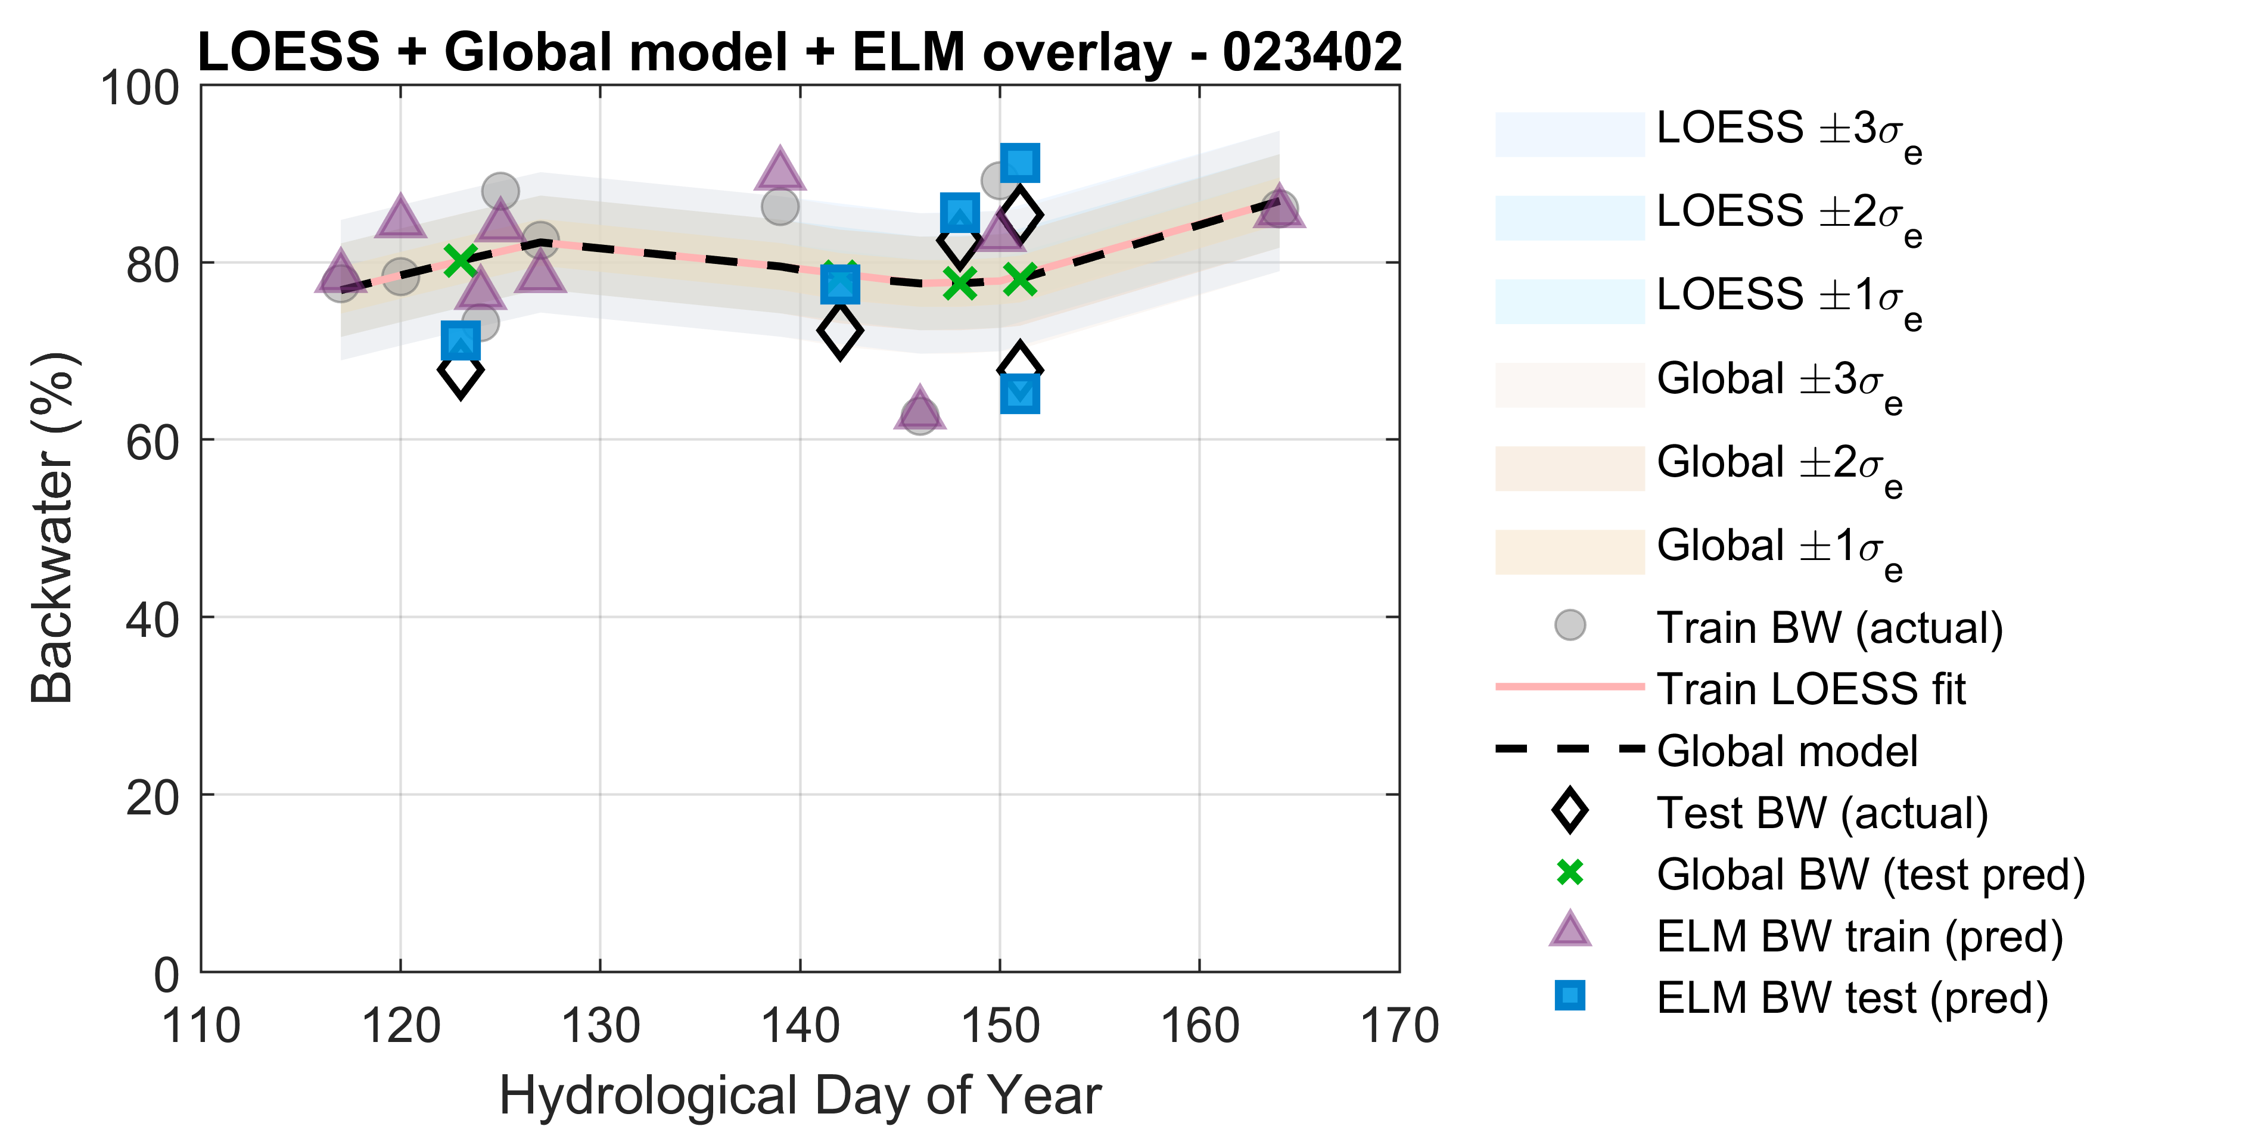
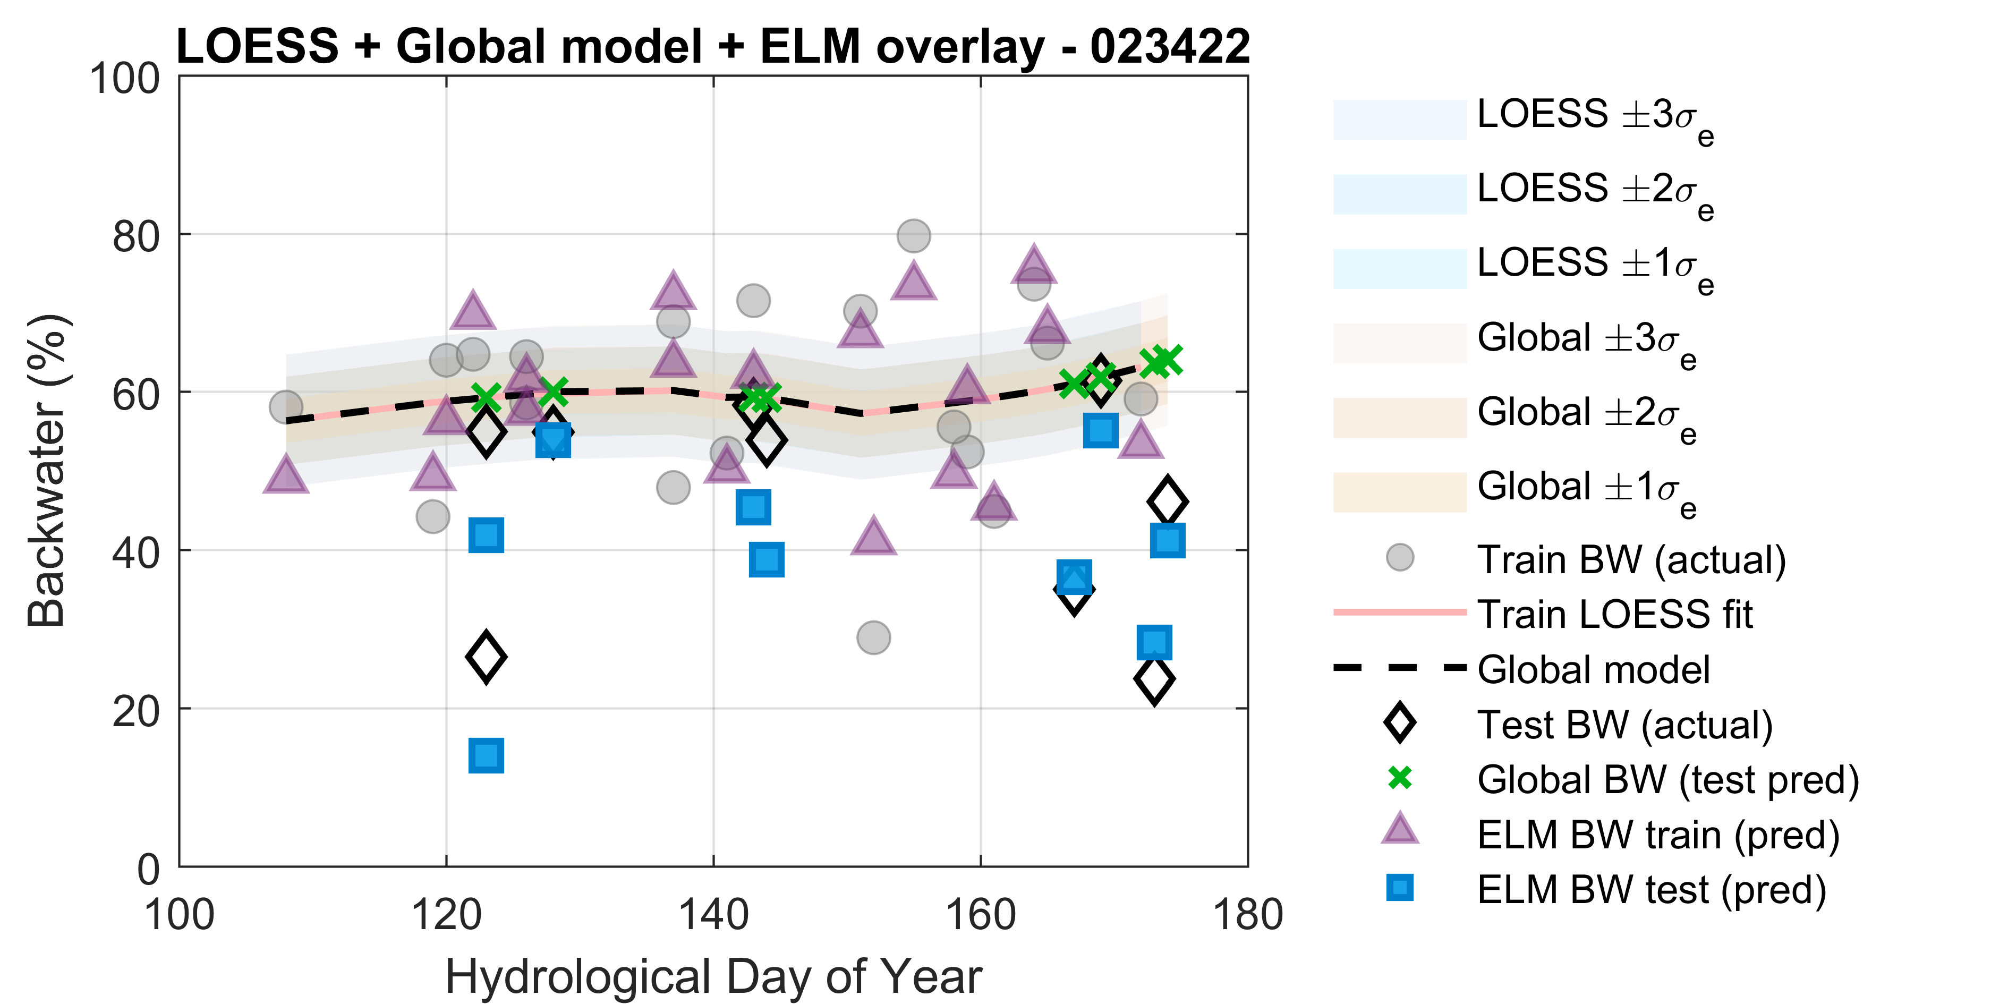
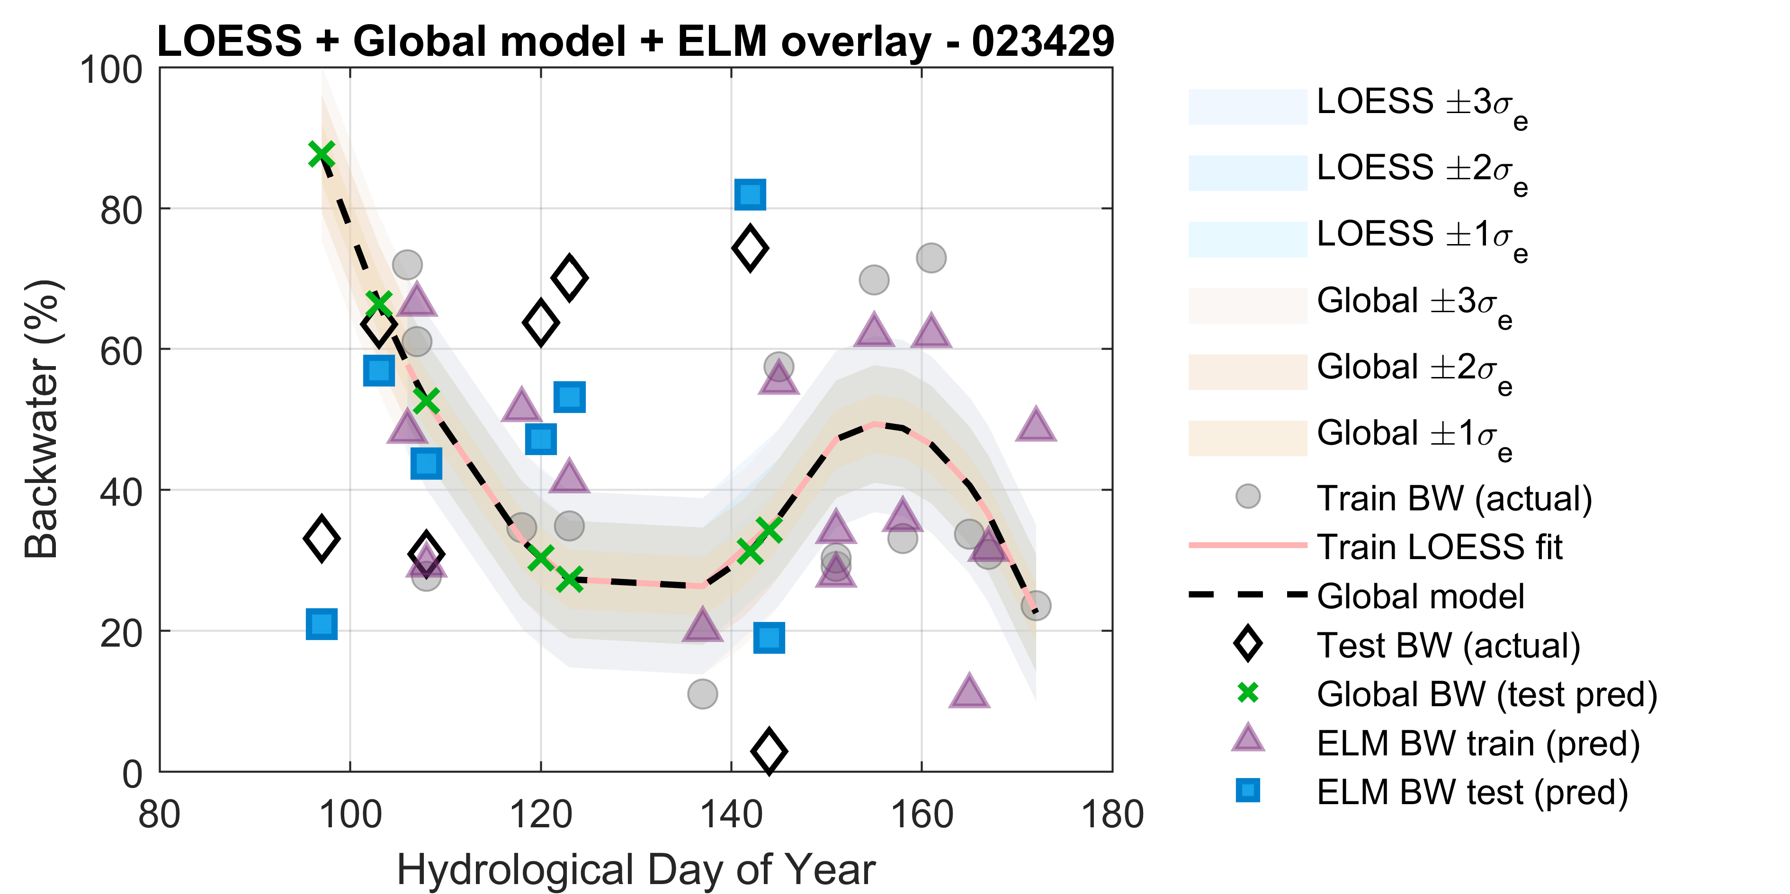
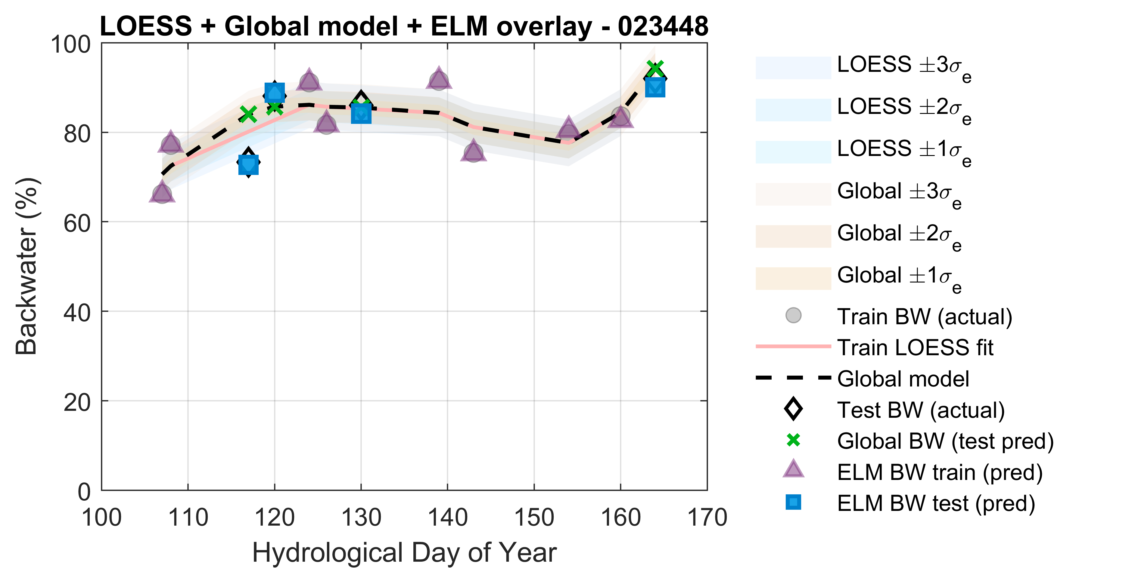
Résultats
2
3
4
5
6
1
2
LOESS + ELM
Fig. 20 LOESS scatters.
Notes:
In this slide, the predictions of the ELM and LOESS are presented. Green cross marks are loess predictions and blue squares are elm predictions on external test section. You can see that the predictions of the ELM are closer to actual values compared to the LOESS and correlation is higher for this ML method.

Slide 25
Résultats
Martin
1.HDOY
5. T_PRCP
6.T_SNOW
2.Min Temp
2
3
4
5
6
1
2
Résultats de la validation croisée et de l'évaluation externe
Cross-Validation assessment results for all Quebec sites
Lambert
1. HDOY
4. Max Temp
5. T_RAIN
7. SNOW_OG
2. Min Temp
Famine
2. Min Temp
7.T_SNOW
1. HDOY
3. Max Temp
Georges
1. HDOY
7. SNOW_OG
25
Fig. 18 Best climatic input combination for each site.
Notes:
Here you can also see how different inputs contributed in site-specific model.
Total snow and temperature were the dominant inputs in the all stations and depending on the noise and size of the data, other inputs were involved.

Slide 26
Conclusion
LOESS (Modèle de référence)
• Très sensible à la taille de l'échantillon et au régime expérimental
• Faible aptitude externe sur la plupart des sites (R ≈ 0,16 en moyenne)
ELM vs LOESS (Modèle de référence)
• R externe : ↑ d'environ 0,16 à environ 0,9
• RMSE, MAE : ↓ d'environ 70 à 75 % par rapport à LOESS • Gain net en précision et en robustesse
Stabilité et généralisation
• R de validation croisée élevé et proche du R externe
• Erreurs de validation croisée légèrement conservatrices • Stabilité algorithmique, notamment chez Lambert et Martin.
LOESS (Benchmark model)
• Highly sensitive to sample size and regime • Very weak external skill at most sites (R ≈ 0.16 on average)
ELM vs LOESS (Benchmark)
• External R: ↑ from ≈0.16 to ≈0.9 • RMSE, MAE: ↓ by ≈70–75 % vs LOESS • Clear gain in both accuracy and robustness
Stability and generalization
• CV R high and close to external R • CV errors slightly conservative • Algorithmically stable, especially at Lambert, Martin.
Notes:
In summary, LOESS proved highly sensitive to data size and site variability. With these small and heterogeneous datasets, the benchmark model has low predictive skill on the external sets. The mean test correlation across the sites is only about 0.16, and errors are large. It works better at sites with more samples like Big East and Raven.
When we move to ELM, performance changes considerably. Across the 4 sites, the external correlation increases to roughly 0.9. At the same time, the RMSE and MAE are reduced by about 70 to 75 percent relative to LOESS.
In terms of stability, the cross validation results are consistent with the external validation. Cross validation correlations are high and very close to the external values, and the cross validation errors are mostly slightly larger than the external errors. This means the cross validation procedure is not over optimistic and can be trusted for model selection.

Slide 27
Conclusion
Inputs vs accuracy
• No simple monotonic relation between number of inputs and accuracy in site-specific models
Site dependence
• Accuracy limited by site heterogeneity and noise, not only input count
Optimal complexity
• Best models use parsimonious, physically meaningful subsets
Future improvement
• More site specific data: channel geometry, morphodynamics, operations • Test other learning methods and nonstationary regimes
• Focus on informative hydrometeorological and hydraulic drivers
Données d'entrée et précision
• Absence de relation monotone simple entre le nombre de données d'entrée et la précision des modèles spécifiques à un site.
Dépendance au site
• La précision est limitée par l'hétérogénéité et le bruit du site, et pas seulement par le nombre de données d'entrée.
Complexité optimale
• Les meilleurs modèles utilisent des sous-ensembles parcimonieux et physiquement pertinents.
Améliorations futures
• Davantage de données spécifiques au site : géométrie du chenal, morphodynamique, exploitation.
• Tester d'autres méthodes d'apprentissage et des régimes non stationnaires.
• Se concentrer sur les facteurs hydrométéorologiques et hydrauliques informatifs.
Notes:
After scrutinizing the results, we found that there is no simple monotonic relationship between input count and performance in the site-specific model. Some of the most accurate site specific models, such as Lambert, use only three inputs, while Martin achieves very high skill with a larger set of eight inputs.
For these sites, the limitation is more related to measurement noise, and unobserved drivers than to the number of variables we feed into the model.
Overall, the search procedure tends to favor parsimonious, physically meaningful subsets of variables rather than very large feature sets.
The optimal complexity is clearly site specific. In small sample settings such as these, carefully chosen hydrometeorological and hydraulic drivers can perform as well as or better than richer input sets.
Finally, to improve further, the models will likely benefit from additional site specific predictors, especially morphological and channel geometric characteristics and information on hydraulic structures or operations. Testing other learning methods and explicitly handling nonstationarity would help assess generalizability and push performance further.

Slide 28

Notes:
Thank you for your attention. I’m happy to answer your questions.

